Slide 1
Classifying heuristic textual practices in academic discourse A deep learning approach to pragmatics
Maria Becker, Michael Bender, and Marcus Muller

Slide 2
Aim of this paper
to detect heuristic textual practices in academic discourse across various scientific disciplines
Heuristic textual practices are linguistic implementations of decision routines in research processes (reduce complexity, conceptually shape a research topic, contextualize it in academic discourse):
“highlighting the relevance of a research topic”
“defining a concept”
“supporting a statement argumentatively”

Slide 3
Aim of this paper
to investigate which linguistic features are characteristic of these practices,
to what extent such textual practices occur in different scientific disciplines,
and how they are distributed and combined.
To study the effects that domain-specific contexts have on heuristic textual practices.

Slide 4
Почему именно такие категории
There are patterns on the linguistic surface of utterances that could be used as indicators for detecting pragmatic categories.
linguistic patterns may give hints about the heuristic function of utterances (the relevance of the particular approach is claimed, among others, with the expressions von besonderer Bedeutung (“of special importance”, used in 11 out of 65 doctoral theses introductions) and besonders wichtig (“particularly important”, used in 20 introductions).

Slide 5
Challenge (theoretical questions)
“Pragmatic meaning has even less predictability than, say, semantic meaning, and this in turn presents a particular challenge for computational corpus analysis, where (usually) manual- or semi-automated annotation is the only route for comprehensive pragmatic research” (Archer et al., 2008:615). → pragmatic tagging - hermeneutical manual task
have to deal with small corpora; large corpora are preferred over small datasets → large datasets with annotations of questionable reliability are not helpful when analysing complex pragmatic phenomena.
Heuristic textual practices can only be clearly classified by “close reading” and individual hermeneutic analyses by human annotators trained in pragmalinguistics.

Slide 6
The central research questions of this article are:
i. To what degree can the algorithm learn to assign pragmatic categories of a complex annotation scheme?
ii. Are our annotation categories robust enough to be learned by data-hungry neural networks?
iii. What granularity of annotations can be captured by neural approaches?

Slide 7
Materials
65 doctoral dissertations (introductions)
Humanities, natural sciences, social sciences
German (translated into English by authors)

Slide 8
Annotation scheme
Pragmalinguistic categories + deep-learning architectures
automatically classify these categories
Annotate the texts in corpus manually (Catma) by trained experts
Develop annotation guidelines (examples + linguistic indicators for each category)
Train a machine learning processes (!on small dataset)
the manually developed annotation categories are robust enough to be recognised by RNNs with the required accuracy
Notes:
Thus, we first annotate the texts according to functional-pragmatic criteria (see Sections 3.2 and 3.3), and then use this basis to train machine learning algorithms that learn similarities of the (linguistic) surface of the annotated sentences represented as word embeddings.

Slide 9
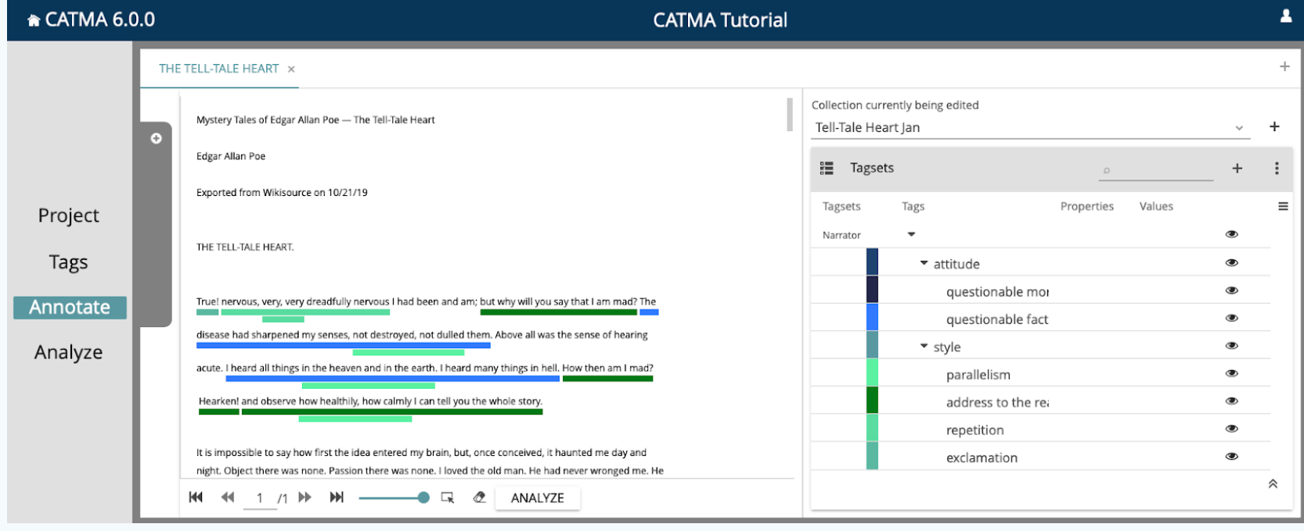
Catma

Slide 10
Data and annotation process: corpus
Introductions of 65 doctoral theses from 13 different faculties
Segmented into sentences + annotated to their heuristic textual practice
3362 sentences
the chapter structure is not uniform

Slide 11
Data and annotation process: segmentation
Units which are tagged – sentences
Simple & compound sentences
Each sentence – a single annotation category
→ Annotation classifies complete sentences

Slide 12
“Relevance Marking by the Description of Subject”
not a genre-specific rhetorical structure, but at pragmatic practices with an epistemic function. The textual practices annotated here are not regarded as ‘moves’ and ‘steps’ constituting a genre but as linguistic ways of reducing complexity.
these textual practices differ from discipline to discipline in the order, density and combination in which they are carried out. The target of our study, hence, is not ‘genre’ but ‘epistemic culture’.

Slide 13
Data and annotation process: annotation scheme
Under the term ‘heuristic text practices’, we subsume linguistic practices with which scientists and scholars:
i. Mark the necessity of studying an object of investigation (“Relevance Marking”);
ii. Describe their research objective (“Objective”);
iii. Formulate a thesis (“Thesis Formulation”);
iv. Define terms (“Definition”);
v. Establish causalities and backing assertions by
a. Substantiating a fact (“Reasoning”) or
b. Relying on consensual knowledge with an argument (“Argumentation”).
Notes:
+ страница 13 пдф

Slide 14
Data and annotation process: annotation process
Preliminary annotation scheme (optimized during the course of project);
1st annotation by the authors, then – 3 trained student assistants annotated the entire pilot corpus;
Double annotation of some of the texts; other texts – by 1 or 3 expert annotators;
Cases of doubt and differentiations of categories were discussed at regular team meetings;
Last version of the annotations – controlled and corrected by the authors

Slide 15
Data and annotation process: inter-annotator agreement
Based on the 26 documents that were annotated twice, we measure inter-annotator agreement using Cohen’s Kappa.
Cohen’s Kappa (ĸ) is an evaluation measure of annotator agreement which expresses a relationship between the expected coincidence and the actual observed match.

Slide 16
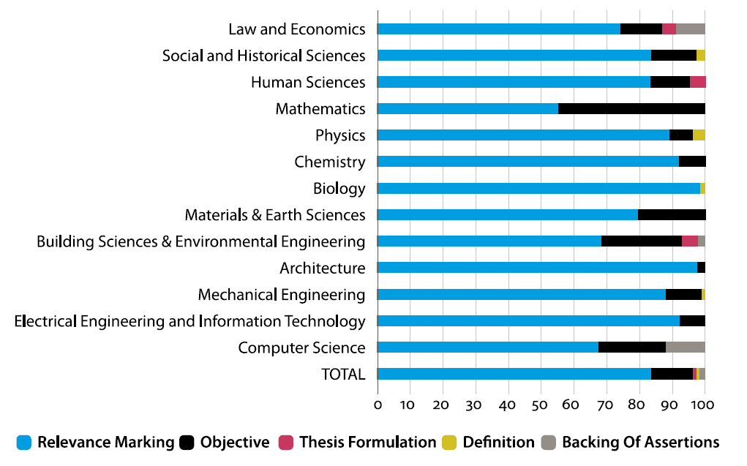
Distributions: general observations
Distribution of labels within the different faculties
(complete dataset)
In percentage, annotation level 0

Slide 17
Distributions: general observations
The main text routines have the function of marking the relevance of the research topic and giving an outlook on the approach and the associated objectives.
thesis formulations, definitions, and backings of assertions are often to be found only at one single point in the introduction, to which the relevance marking leads or which is the starting point for the formulation of objectives.

Slide 18
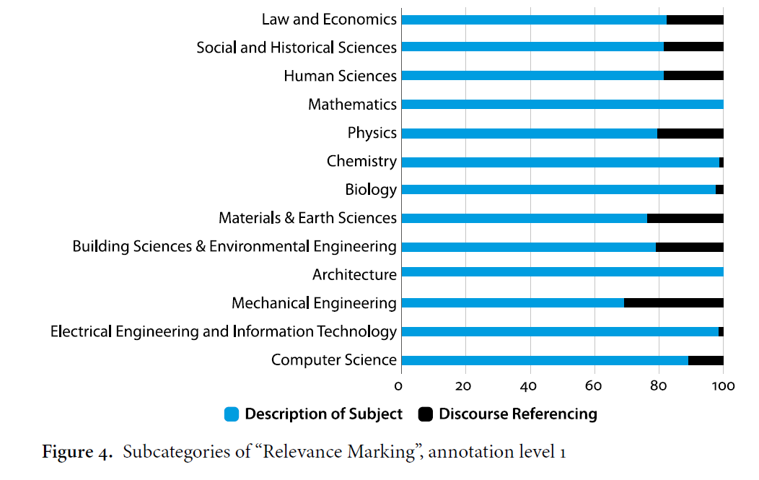

Slide 19
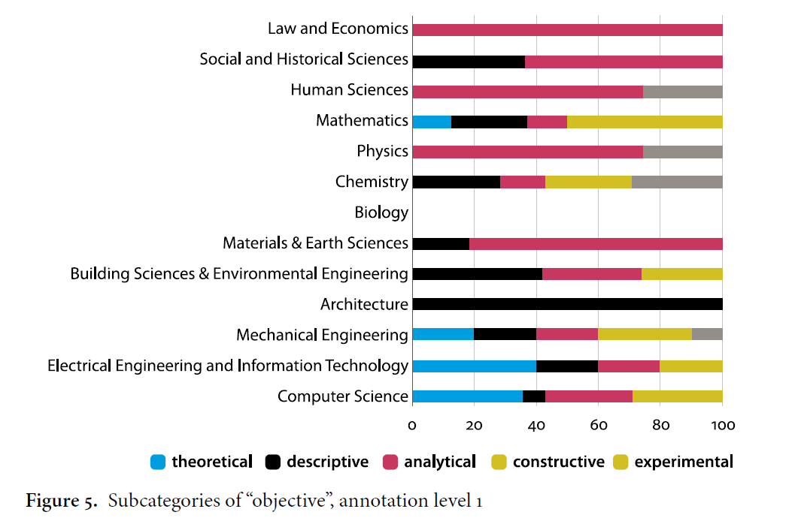

Slide 20
Corpus approaches to academic discourse: библиография
CARS model (Create a Research Space) of Swales (Swales 1990:141, originally published in 1981) – the definition of “moves” (content-related & functional elements of the introduction)
Cotos et. al.(2017:90-106): a model for rhetorical composition of research article methods sections
Kanoksilapatham (2005, 2007): a coding-sheme of moves and steps representing the rhetorical structure of four sections – introduction, methods, results and discussion - in biochemistry research articles
Burton (2002): further differentiates the categories of the CARS model and follow-on models, supplementing them with further categories + he examines these ‘moves’ not only in introduction

Slide 21
Corpus approaches to academic discourse: библиография
Bhatia (2002:21): describes genres as “reflections of disciplinary cultures”
Thompson (2016): analyses the use of certain types of words in academic discourse, such as modal verbs or abstract nouns

Slide 22
Building a semantically annotated corpus of clinical texts
https://www.sciencedirect.com/science/article/pii/S1532046409000069

Slide 23
Давайте посмотрим на наши теги
https://docs.google.com/document/d/1FWiLnvIKYgQLEr0aqg1rWjRgmwCKBwkS/edit
Чем наша разметка/наши теги отличаются от того, что было ранее предложено?
Для какой цели мы размечали тексты именно так?
Какую функцию выполняют наши теги?
Нет ли у нас пересечений в тегах? Все ли теги мы можем четко описать?
Смогла ли нейросеть обучиться по нашей системе тегов?

