Slide 1
О понятии lexical bundles и его расширениях: обзор подходов к выделению устойчивых и дискурсивно-значимых сочетаний академического текста.
Функциональный подход (function-first approach, Durrant&Mathews-Aydinli 2011).
Корпусные подходы
Зевахина Н.А.
Доклад в рамка рабочей научно-учебной группы
«Язык современных академических текстов в свете корпусных данных:
риторические параметры и их лингвистическое представление»
№ 21-04-059

Slide 2
Lexical bundles
Multi-word expressions (collocations) that are frequently used in academic texts and are automatically identified in corpora; glued together and are likely to be easily retrieved from mental lexicon
Examples (functional and content words): in terms of the, it was found that, as shown in fig., in the case of
A well-studied phenomenon in English => other languages?
4-word lexical bundles:
are more frequent than 5-word bundles;
are supersets of 5-word bundles;
specific for English?

Slide 3
Building a corpus: academic texts and disciplines
Novice academic texts (student texts) various disciplines
Academic journal texts
⇓ ⇓
⇓
Developing a corpus
(2-3 million words)
⇑
Various time periods

Slide 4
Doug Biber et al.’s papers
Comparisons between classroom vs. written academic discourses
Cortes
Comparisons between professional vs. student written academic discourses
Naixing, other authors: comparisons between L1 and L2 written discourses

Slide 5
Disciplines
hard sciences (electronic engineering and biology)
soft sciences (applied linguistics and sociology)
Distribution of lexical bundles
Distribution of types (лексемы)
Distribution of tokens (словоупотребления)
Micro-diachronic change (1965, 1985, 2015)

Slide 6
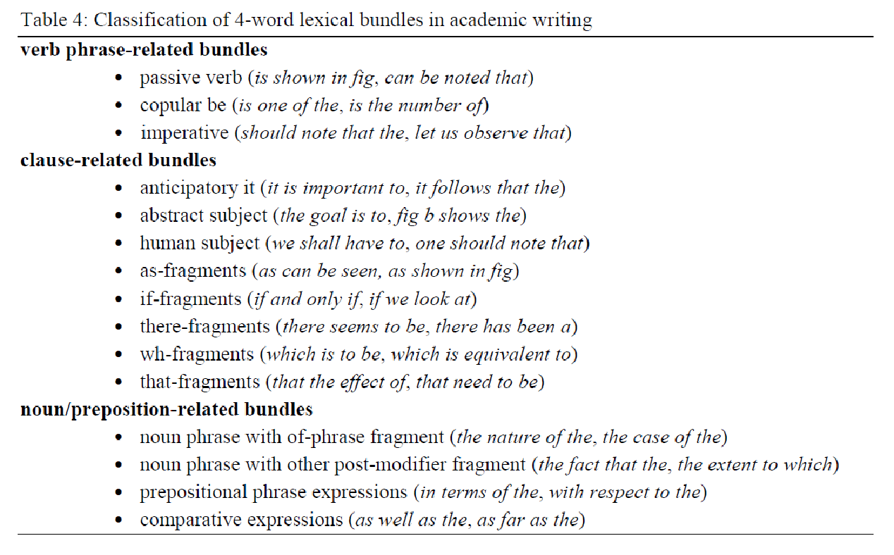
1. Tagging: parts of speech

Slide 7
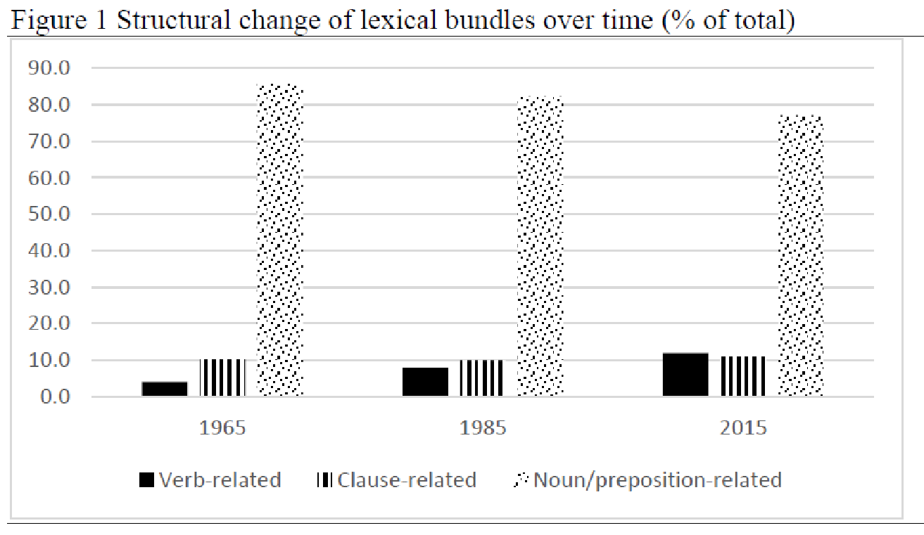
1. Tagging: Variation of parts of speech over time

Slide 8
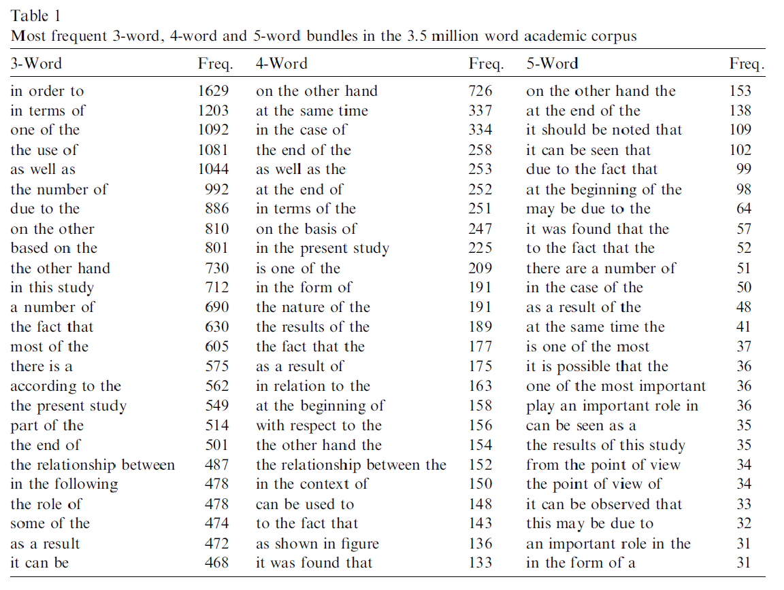
2. Corpus: variation in types and tokens

Slide 9
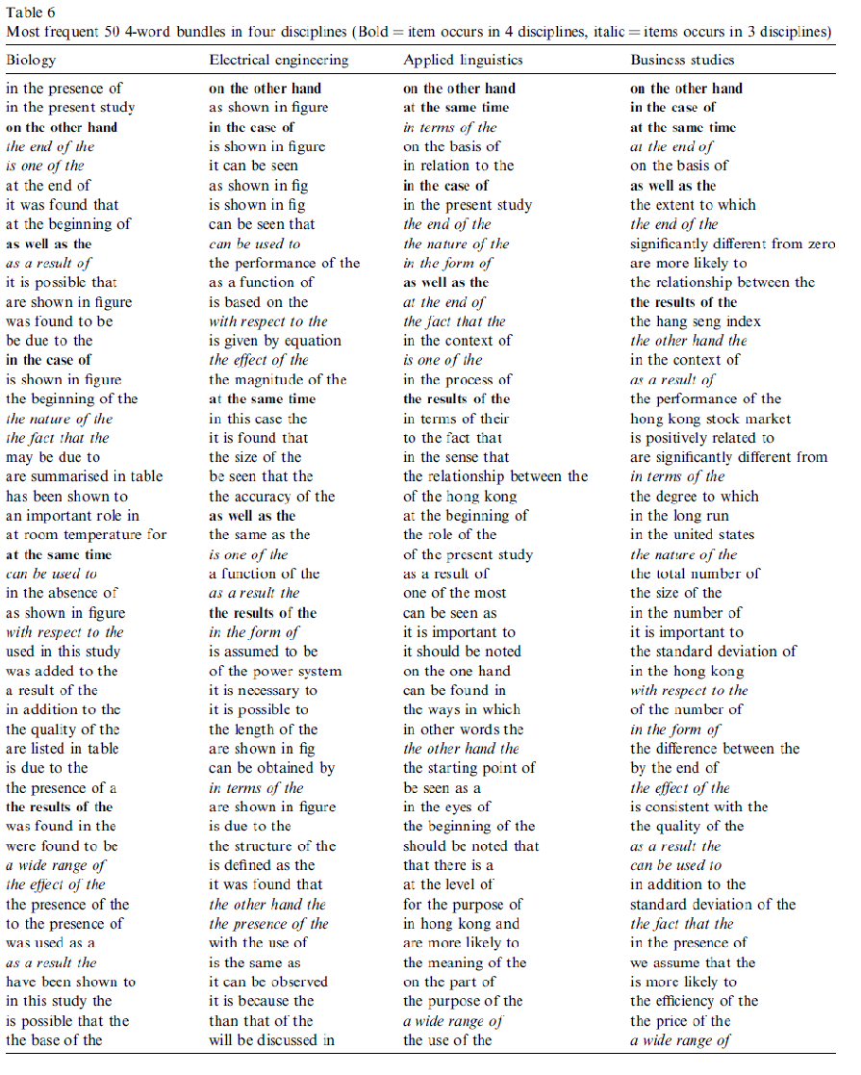
3. four-word bundles in various disciplines

Slide 10
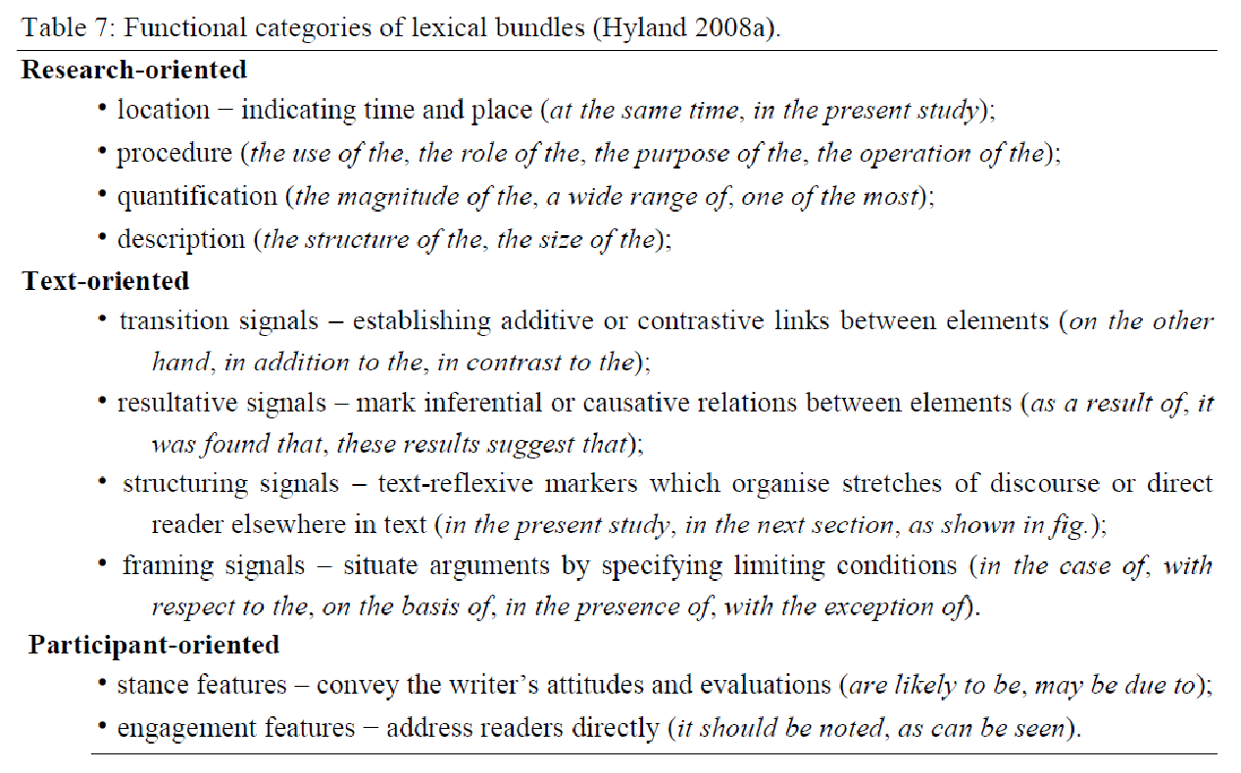
4. Tagging: semantic categorization

Slide 11
4. Tagging: distribution of semantic categories

Slide 12
Overview of a diachronic corpus

Slide 13
Theoretical settings
Usage-based and corpus-driven approaches
Discourse units (“building blocks of discourse” – Biber et al. 2004) rather than grammatical or idiomatic units
Partial and indirect support of Construction Grammar
Russian: no previous literature
Hypotheses based on the previous literature: 1) n-word bundles; 2) motivation for disciplines and corpus size; 3) cross-linguistic validity of the semantic categorization and the parts of speech categorization; 4) variation of the two categorizations across disciplines (?)
Statistical analyses: distributions (tables and figures); chi-square distribution, log likelihood
Conclusions: combine introduction and results
Notes:
Гипотезы общие:
Лиза Карпова (2-4-грамы: 2-грамы хорошо справляются с терминологией; дискурсивные единицы вида «тем самым»; 3-грамы тоже хорошо справляются с дискурсивными единицами «в первую очередь», а также с лексической фразеологией «ценности и ориентиры», «права и свободы»; 4-грамы -- с союзами «в то время как» и т.д.)
Гипотезы case study:
Pre-study для причастных оборотов в постпозиции на материале НКРЯ
Дефектность парадигмы причастий (грамматические профили 2018 Лора Янда less is more)
Частотность грамматических форм и глагольных лексем по дисциплинам (какие коллокации выходят на первый план – pre-study)

Slide 14
Function-first approach Durrant&Mathews-Aydinli 2011
Focus on formulaic expressions of academic texts
What phrases constitute academic formulaicity
(Biber, 2009; Hyland, 2008; Simpson-Vlach & Ellis, 2010)
and thanks to this work we are starting to build up a clearer picture of academic formulaicity

Slide 15
Pedagogical definition of formulas
Taking these points onboard, we propose revising Palmer’s formulation to define formulas pedagogically as:
successions of linguistic entities that are best learned as integral wholes or independent entities, rather than by the process of placing together their component parts, either because (a) they may not be understood or appropriately produced without specific knowledge, or (b) because they occur with sufficient frequency that their independent learning will facilitate fluency.

Slide 16
Function-first approach
The first stage in our analysis was to annotate the student essays for communicative functions. This annotation was based on Swales’ notion of ‘generic moves’ (1990). A ‘move’ is defined as “a discoursal or rhetorical unit that performs a coherent communicative function”. A move “is a functional, not a formal unit” and so is “flexible in terms of linguistic realization”. It may be realized, at “one extreme, by a clause, and, at the other, by several sentences”. (Swales, 2004, pp. 228-229).

Slide 17
Corpus-based approach and n-gram analysis
The Corpus of Social Science Research Article Introductions (COSSRAI) aligned with the rhetorical move-steps that they occurred in.
COSSRAI contains the introduction sections of 600 research articles published in leading journals in six social science disciplines.
The corpus was manually annotated for rhetorical move-steps using an extensively adapted version of Swales’ (2004) Create a Research Space model.
A list of phrase-frames was extracted from the corpus using a combination of corpus statistics and manual filtering.
The phrase-frames were then systematically mapped to the rhetorical move-steps they occurred in.
Three types of phrase-frames emerged from our analysis: specialized phrase-frames that occurred in one move-step only, semi-specialized phrase-frames that occurred primarily in one move-step but also in others, and non-specialized phrase-frames that occurred in multiple move-steps with no clear association with any of them.

Slide 18
Reference list: to read
Biber, D. (2006). University language: A corpus-based study of spoken and written registers. Amsterdam: Benjamin.
Biber, D., Conrad, S., & Cortes, V. (2004). If you look at. . .: Lexical bundles in university teaching and textbooks. Applied Linguistics, 25L, 371–405.

