Slide 1
COMPARING AUTOMATED ESSAY SCORING SYSTEMS AND AUTOMATED WRITING EVALUATION ONLINE SYSTEMS WITH REALEC INSPECTOR
Prepared by Musaeva Irina on 27.04.2017
The presentation was prepared within the framework of the Academic Fund Program at the National Research University Higher School of Economics (HSE) in 2016 — 2017 (grant №16-05-0057) and by the Russian Academic Excellence Project «5-100»

Slide 2
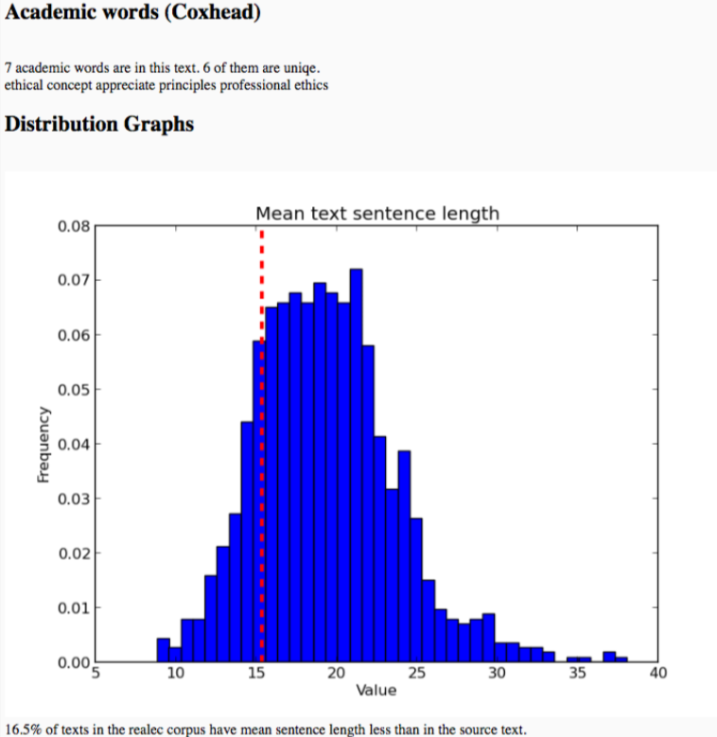
REALEC Inspector
FEEDBACK
CEFR distribution
Frequency statistics
Academic words statistics
Distribution graphs
‘What may be improved’ recommendations
DESIGN
Simple and easy to work with
All feedback is presented in separate blocks

Slide 3
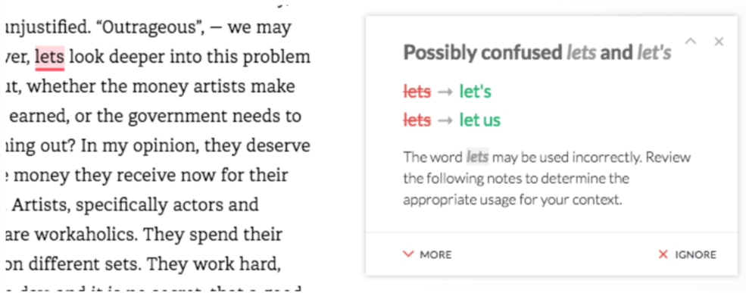
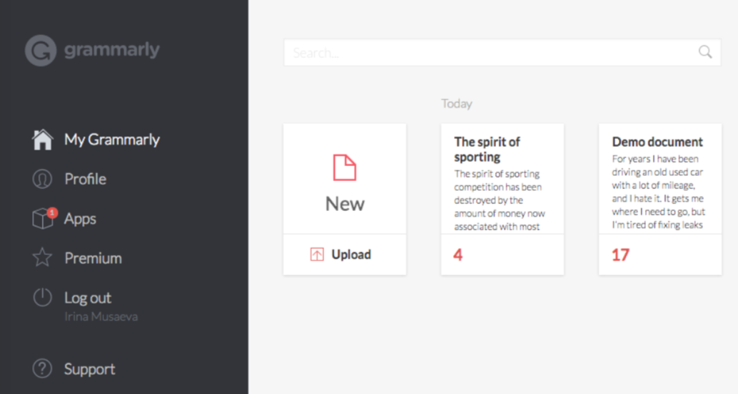
Grammarly
FEEDBACK
Mistakes are highlighted in the text
Grammar and punctuation mistakes are explained
DESIGN
For logged in users only
Profile page
Text view mode

Slide 4
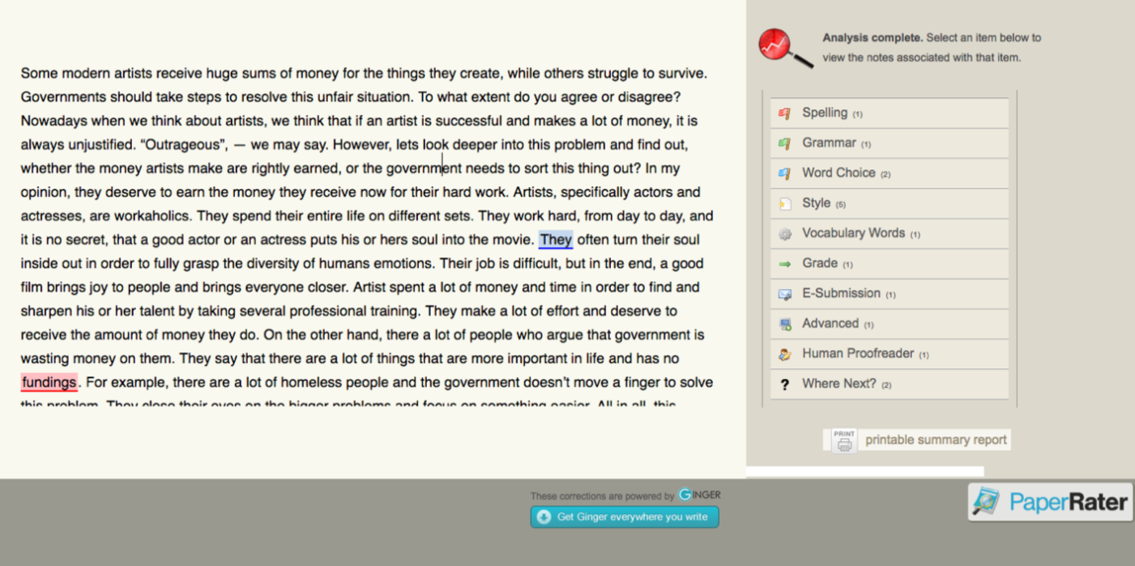
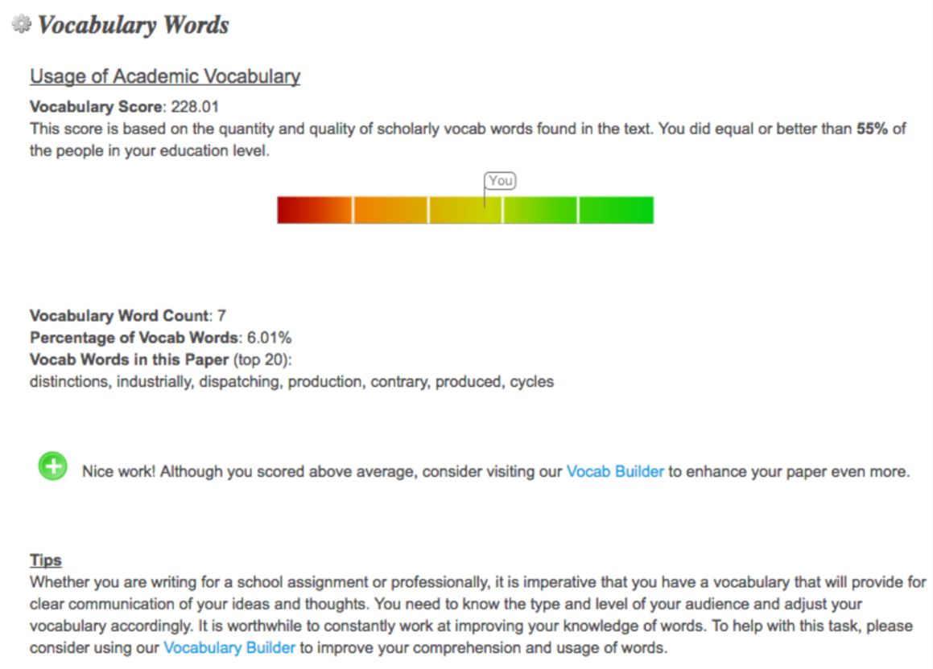
PaperRater
FEEDBACK
Spell-check
Grammar: correcting mistakes and provides explanation
Word choice: counts the number of bad phrases
Style: statistical information + suggestions for improvements
Vocabulary: counts the number of words of certain register and provides suggestions of improvements
DESIGN
Intuitive
All the criteria featured in the feedback appear on the right-hand side, the text itself – on the left-hand side

Slide 5
Conclusion
REALEC Inspector gives information about syntactical complexity of the submitted text and provides some statistics
What can be improved: more criteria added, explanations employed, mistakes highlighted in the submitted text.

Slide 6
