Slide 1
Оценка автоматичсекого парсинга
О.Н. Ляшевская, И.М. Пантелеева

Slide 2
Dependency annotation scheme
Here we show the automatic output and gold parses respectively

Slide 3
Choice among alternatives

Slide 4
Parsing and manual corrections
UDPipe (Straka et al. (2016)) trained on English UD 2.0 treebank
Like any parser, UDPipe makes mistakes, and it was important to evaluate the output for our purposes
373 random sentences (7196 tokens, including 756 punctuation marks) from students’ essays were checked to evaluate the UPpipe parser quality.
the heads were detected correctly for 6688 nodes (UAS 92,9 %)
6894 nodes (95,8 %) were labeled correctly

Slide 5
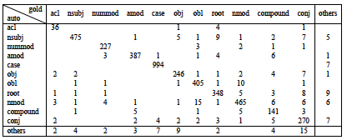
Confusion matrix and causes of errors

Slide 6
Constructions that require attention
Syntactic homonymy

Slide 7
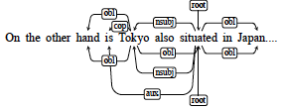
Constructions that require attention
Errors influenced by word order

Slide 8
Constructions that require attention
Spelling and grammar mistakes made by students

Slide 9
Constructions that require attention
Participial construction
Tokyo railway, opened in 1927, was only 155 kilometres on route but, compare to previous system, helped to travel to almost 2000 millions passengers.

Slide 10
Constructions that require attention
Introductory constructions
Accordingly , the same situation as in the proportion of skilled vocational diploma is in postgraduate diploma.

Slide 11
Conclusion
the annotation principles of learner data and evaluation of automatic parsing quality were presented
exploration of students’ errors that are critical for the parser and that are not
output of parser were checked and cahnged
suggestion for improvement

