Slide 1
MULTI-LEVEL STUDENT ESSAY FEEDBACK IN A LEARNER CORPUS
12.06.2017
Vinogradova Olga,
Lyashevskaya Olga,
Panteleeva Irina

Slide 2
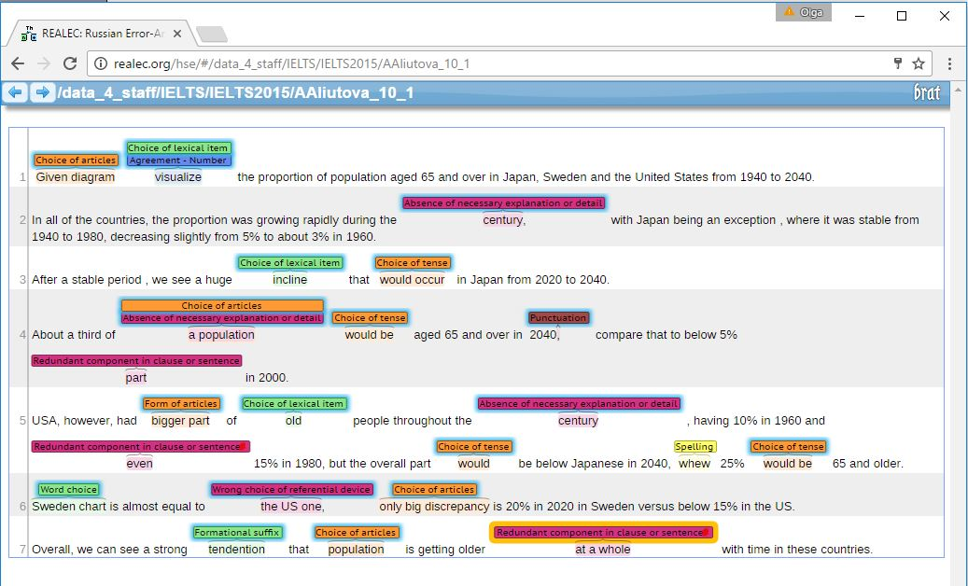
Russian Error-Annotated Learner English Corpus
(School of Linguistics, Higher School of Economics)
СКРИНШОТ

Slide 3
Objectives
Error statistics across the ‘best’ and ‘worst’ essays
Selection of lexical and syntactic complexity features as
indicators of a successful / unsuccessful text
Ultimate goal:
Automatic essay feedback that a student can
get after uploading his / her essay in the corpus

Slide 4
Experiment setup
Collection:
1000 essays describing graphs
1000 argumentative essays
With focus on:
‘best’ (graded 75% and over)- 33 essays
‘worst’ (graded 30% and lower) - 43 essays

Slide 5
Error analysis
 | Essays scored 75% and higher | Essays scored lower than 30%
Average number of all error tags in one essay | 19 | 19.5
Minimum and maximum number of all error tags | 3 to 60 | 10 to 66
Average number of syntactic errors | 2 | 3
Average number of discourse errors | 3 | 3

Slide 6
IELTS
the number of words, relevance to the topic in the question, and coverage of all parts of the question (Task Achievement/Task Response)
organisation, connection of sentences and paragraphs with logical links and referential tools, no or little repetition (Coherence and Cohesion)
use of appropriate academic words and collocations, use of paraphrase to avoid repetition, correct spelling (Lexical Resource)
use of a variety of grammatical forms, combination of short and complex sentences, and not too many grammatical mistakes (Grammatical Range and Accuracy)

Slide 7
Lexical evaluation with REALEC-Inspector
Number of words in the essay
Average length of a sentence in the essay
Length of the longest sentence in the essay
Average length of word in the essay
Length of the longest word in the essay
Number of words of each level of CEFR in the essay
Number of words from the COCA frequency lists
Number of academic words in the essay (with/without repetitions)
9. Number of repetitions of words used in the essay.
10. Number of linking words and expressions in the essay

Slide 8
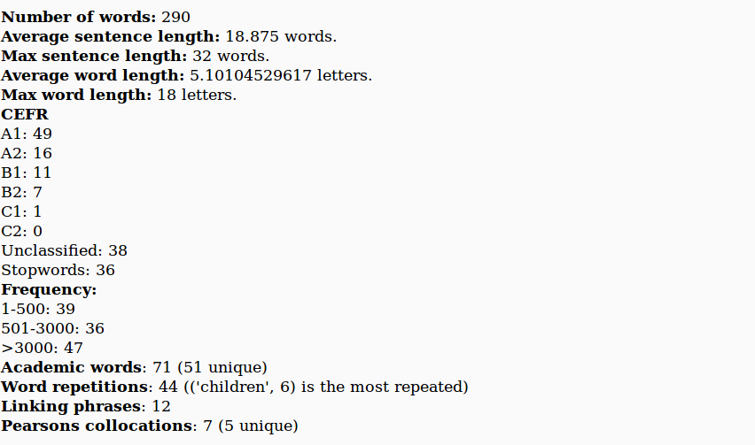
Lexical evaluation with REALEC-Inspector

Slide 9
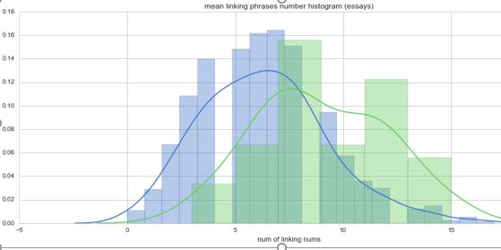
Distribution of linking tools number: good essays vs bad essays

Slide 10
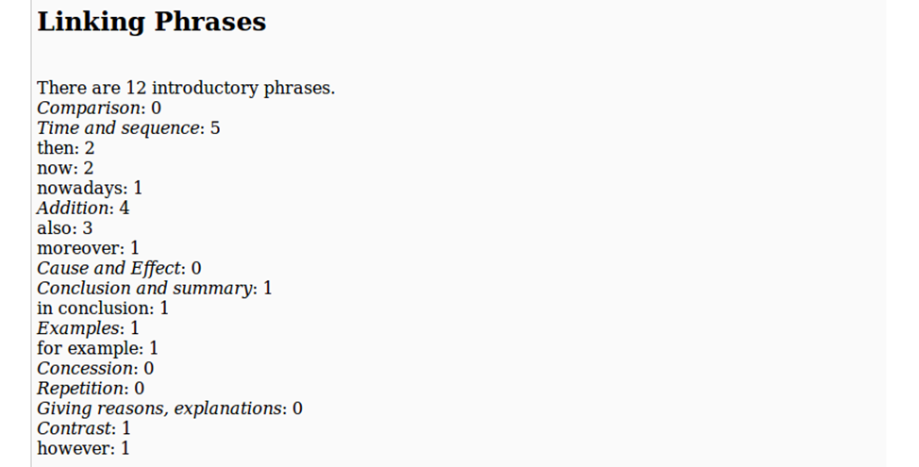
Linking tools statistics

Slide 11
Collocations statistics

Slide 12
Lexical complexity parameters: ‘best’ vs ‘worst’
Parameters for automated lexical inspection | Essays scored 75% and higher |  | Essays scored lower than 30%
 | Task 1 | Task 2 | Task 1 | Task 2
1) Average number of words in the essay | 203 | 292 | 174 | 161
2) Average length of a sentence in the essay (N words) | 21 | 20 | 17 | 16
3) Length of the longest sentence in the essay | 37 | 39 | 33 | 30
4) Number of academic words in the essay (with/without repetitions) | 41/28 | 69/51 | 33 /18 | 42/29
5) Number of linking words and expressions in the essay | 5 | 7 | 3 | 4
6) Number of collocations from the Pearson ACL (with/without repetitions) | 0,8/0,8 | 0,73/0,73 | 0,38/0,35 | 0,38/0,38

Slide 13
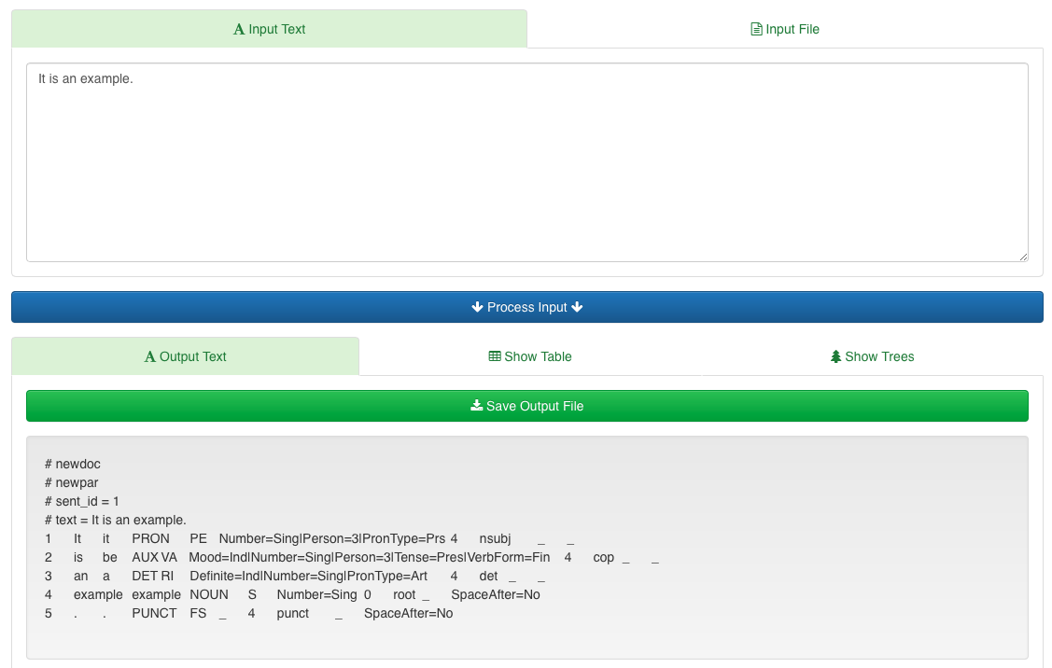
Syntactic complexity
Parsed with UD-Pipe (Straka et al. 2015)

Slide 14
Syntactic complexity
Syntactic depth
Calculated as max path length to the root (2-10)
Subordination
# adverbial clauses (advcl): when, where, why..
# relative clauses (acl:relcl)
# other adnominal clauses, incl. participle groups and which-clauses

Slide 15
POS and syntactic parsing
Subordinate clause types per essay
Grade Cat | mean.acl | mean.acl:relcl | mean:advcl
best | 3 ± 0.82 | 3.25 ± 0.85 | 5.41 ± 1.07
worst | 1.21 ± 0.42 | 1.43 ± 0.38 | 1.86 ± 0.5
Correlation of the syntactic features
 | MeanDepth | N_acl | N_acl:relcl | N_advcl | N_AllSubordCl
Grade | 0.203 | 0.397 | 0.462 | 0.599*** | 0.630
MeanDepth |  | 0.375 | 0.311 | 0.179 | 0.346
N_acl (adnominal clauses) |  |  | 0.355 | 0.383 | 0.698
N_acl:relcl (relative clauses) |  |  |  | 0.548 | 0.785
N_advcl (adverbial clauses) |  |  |  |  | 0.867

Slide 16
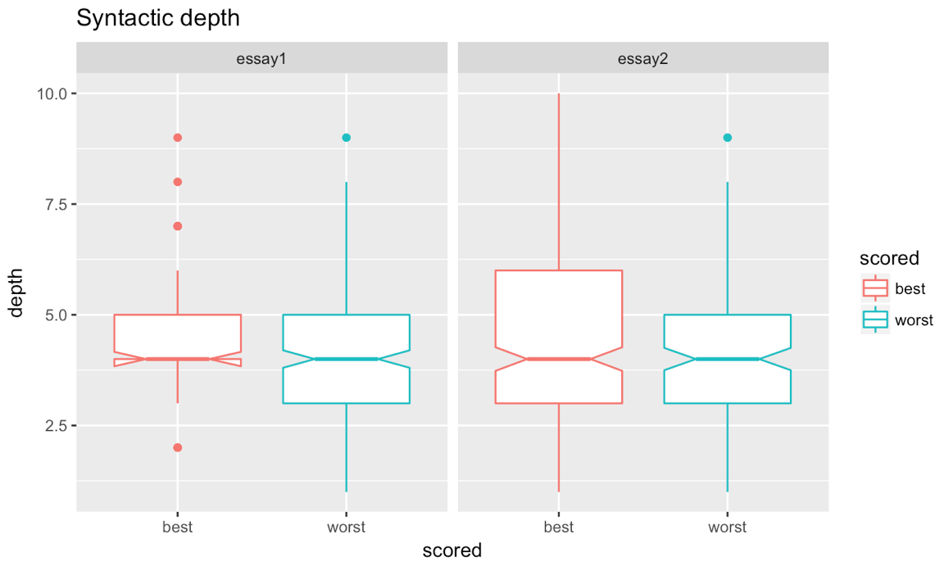
Mean syntactic depth of sentences by essay type and grade category

Slide 17
Conclusions
– word length and number of repetitions are insignificant as indicators of the writing proficiency;
– the numbers of words at each CEFR level and of those with high COCA frequency are to some extent larger in essays highly evaluated by experts
– texts of essays at our disposal were of two types – not less than 150 and not less than 250 words, so for the purposes of our experiment all statistical analysis in the lexical inspection was carried out separately for the two types of essays

