Slide 1
Cross-linguistic comparison of synonyms Valentina Apresjan
International Summer School on Typology and Lexicon (TyLex) 2-8 September 2017

Slide 2
Aim
Theoretical
compare differences in
conceptualization and development of similar
senses across languages
Practical
create a cross-linguistic dictionary of synonyms aimed at a language learner; create online lexical exercises to practice usage

Slide 3
Аttempt at realization: http://web-corpora.net/wsgi3/synonyms2016/far

Slide 4
Two aspects of description and analysis of synonyms:
Differences within particular word senses
Differences in
polysemy

Slide 5
Polysemy vs. semantic features
fast, quick, speedy: | fast | quick | speedy
1. ‘done or happening with a speed greater than average’ | fast run (activity) fast rate <growth> (atelic process) | quick glance <search, response> (achievement or accomplishment - action) | speedy recovery <trial> (accomplishment – process or action)
2. ‘able to move with a speed greater than average’ | fast runner | He is very quick for such a big man | -----
3. ‘able to do something quickly’ | ----- | quick learner | -----
4. ‘lax’ | fast woman | ----- | -----

Slide 6
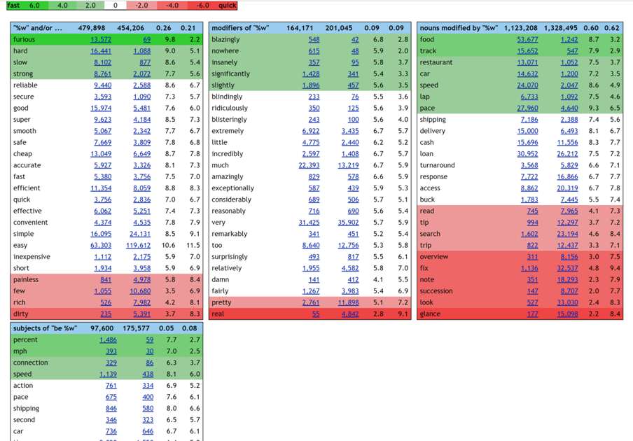

Slide 7
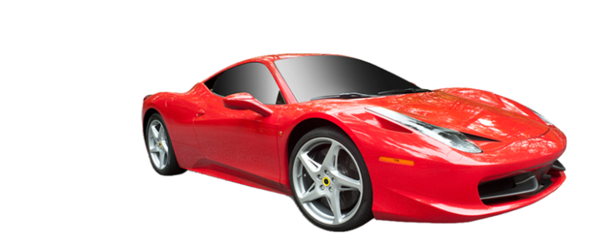
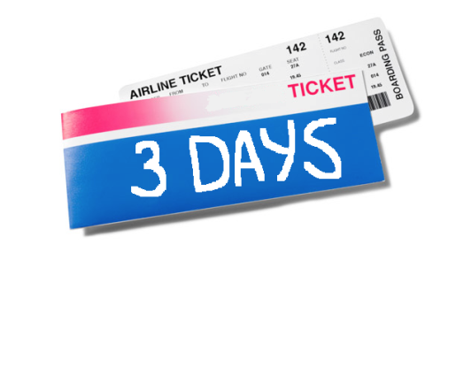
Differences in the speaker’s perception of the event
Differences neutralized:
Thank you for your fast response
=
Thank you for your quick response
Happening fast; each increment of the process or activity is followed by another at short intervals of time
Fast growth
Fast drive
Fast connection
Fast travel ‘on a fast means of transportation’
Taking overall little time; little time elapsed from the beginning of the action to its end
Quick read
Quick look
Quick search
Quick trip ‘taking little time’

Slide 8
Semantic features: other examples
I am finally alone – what relief!
She was alone in the room for 5 minutes
She is alone now, after her divorce
She feels lonely even among friends
He is essentially a very lonely person
After her only daughter moved out, she’s been feeling very forlorn
Alone, lonely, forlorn
Semantic features:
1) lasting/transient state
2) cause of the state
3) feelings induced by the state
4) perception of the state as isolation from other people

Slide 9
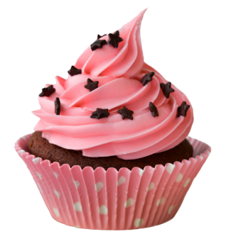
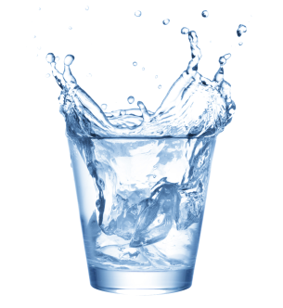
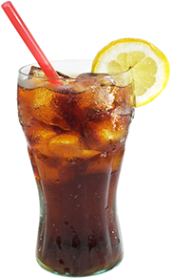
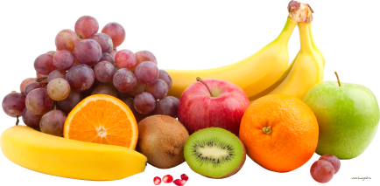
Differences in polysemy: example
English
English
fresh food
‘newly prepared’
fresh water
‘clean, newly poured’
‘not salty’
sweet cake
‘sugary-tasting’
sweet water
‘not salty’
Russian
Russian
svezhaja eda ‘newly prepared’
svezhaja voda
‘clean, newly poured’
‘not salty’
presnaja voda
Lit: ‘unleavened water’
sladkij pirog ‘sugary-tasting’
sladkaja voda
‘sugary-tasting’
‘not salty’

Slide 10
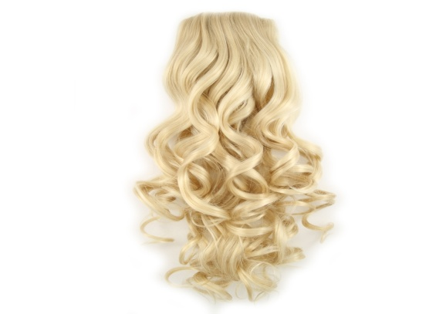
yellow hair vs. zheltye volosy
yellow hair = ‘golden hair, fair hair’
zheltye volosy = probably colored in a very unnatural and unattractive color

Slide 11
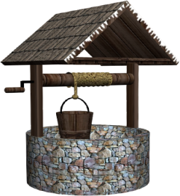
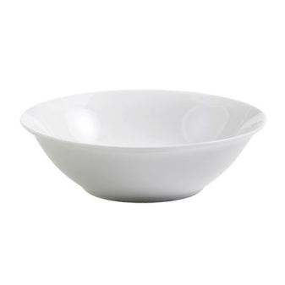
Differences within particular word senses:
deep well glubokij kolodets
deep plate glubokaja tarelka
soup bowl
shallow river
shallow plate
melkaja reka
melkaja tarelka
dinner plate

Slide 12
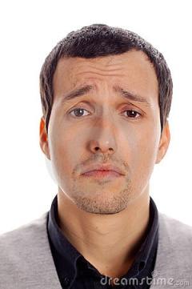
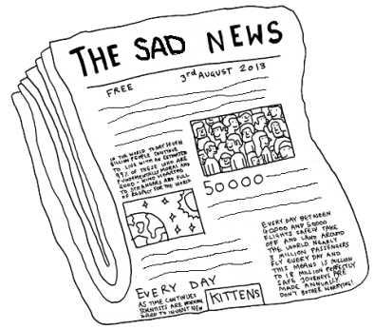
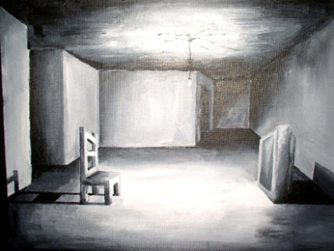
Polysemy vs. word senses: mere convention?
“Vertical” (polysemy) vs. “horizontal” (semantic features) distinctions among synonyms
Polysemy: understanding of regular shifts between different semantic domains
Distinctions among synonyms within one word sense: understanding of the structure
of a particular semantic domain
Consider sad and gloomy.
Polysemy:
1.1. ‘Feeling sad’: He was very sad/gloomy yesterday
1.2. ‘Looking sad’: a sad smile, his gloomy face
2. ‘Causing sadness’: sad facts, gloomy predictions
3. ‘Dark in a way that causes sadness’: gloomy room

Slide 13
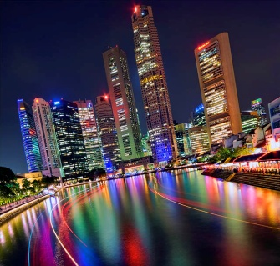
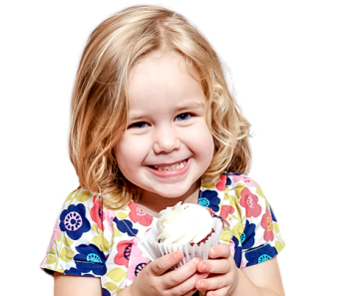
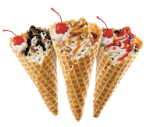
Regular metaphor: ‘feeling’ => ‘color’
Cf. a vibrant city – a vibrant color,
She was feeling young and gay again – gay wall-paper
Regular metonymy: ‘person’ => ‘aspect of a person’
Cf. happy girl – happy smile
Regular metonymy:
‘a person feeling smth.’ => ‘an object inducing
the feeling’
Cf. a happy girl – a happy thought

Slide 14
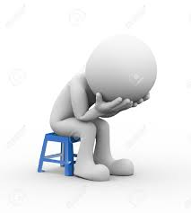
Semantic features: sad vs. gloomy
Regular semantic features of emotion domain:
glad vs. happy (type of event)
contented vs. elated (nature of feeling)
frustrated vs. furious (manifestations)
Cause of the feeling:
feeling sad is caused by various bad events and situations of differing importance:
It made me sad because he couldn't move or even wag his tail
Having raised three daughters, it made me sad to see this girl
being sold the way she was
It made me sad to think that I could not give her a home till I went to work and earned the means
It made me sad to hear him speak like that
feeling gloomy is caused by bleak surroundings or hopelessness in one’s situation:
They feel gloomy and weighed down so they think 'Why not escape to the country'?‘
Of course, most of our trees have bare branches in winter, which on my darker
winter days can make me feel gloomy

Slide 15
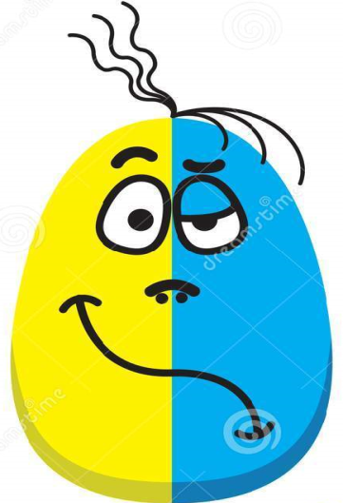
Semantic features: sad vs. gloomy
2) Nature of the feeling
feeling sad can be combined with a positive feeling:
I'm going to be both sad and happy
Marsh told Will Martin from LastBroadcast that he was both
sad and excited to leave "Neighbours"
feeling gloomy is an all-pervasive negative

Slide 16
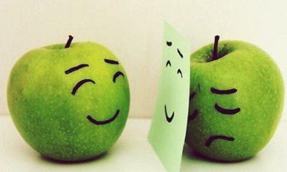
Semantic features: sad vs. gloomy
3) Manifestations of the feeling
feeling sad can be covered:
I feel very hurt and sad inside –only big boys don't cry
feeling gloomy always shows

Slide 17
The process of work:
Monolingual dictionaries
Dictionaries of synonyms
Corpora – phrases; word sketches, incl. sketch differences; parallel corpora

Slide 18
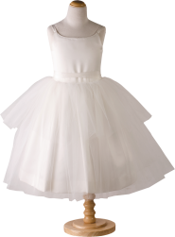
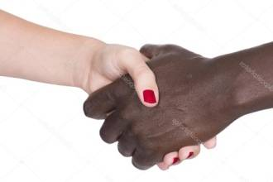
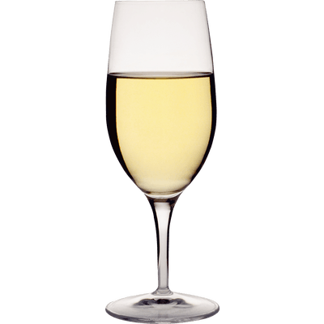
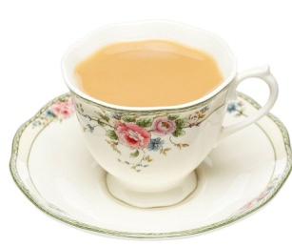
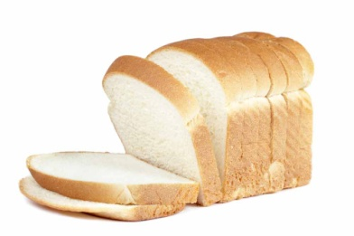
white (Macmillan dictionary) – differences underlined
of same colour as milk: white dress
of race with pale skin: white people, white neighborhood
pale because ill/upset: white with anger
about food/drink:
white wine, white bread, white tea
completely fair/honest: whiter-than-white hero;
The sport’s lily-white reputation has been stained by the affair.

Slide 19
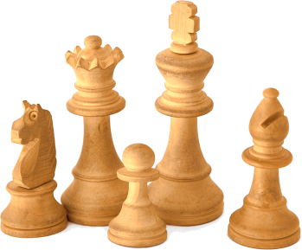
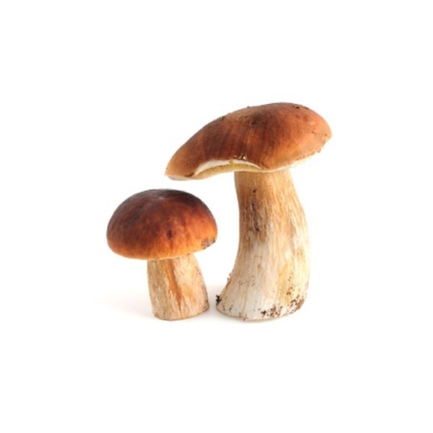
belyj (Active dictionary of Russian)
белый 1 ‘of milk color’: white dress.
белый 2.1 ‘very light’: white skin.
белый 2.2 ‘with light skin’: white people.
белый 3.1 ‘pale’: white with fear.
белый 3.2 ‘gray with age’: white hair.
белый 4 ‘of light time of the day’: black nights and white days.
белый 5 ‘not black in chess’: white knight; to play white.
белый 6.1 ‘not dark’: white wine; white bread; white bear (difference
within the same word sense).
белый 6.2 ‘porcino mushroom’: The first whites appeared in June.
белый 7.1 ‘good’: white magic.
белый 7.2 ‘lawful’: white salary.
белый 8 ‘having fought against the revolutionary armies’: White Guard.

Slide 20
Use of corpora: SkeLL, heavy

Slide 21
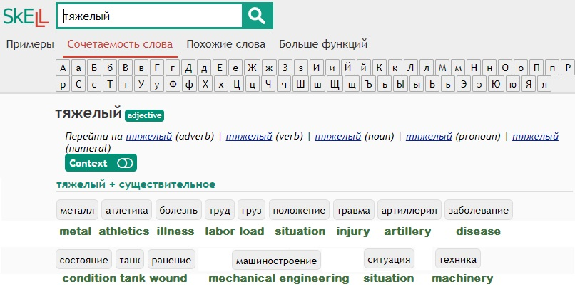
Use of corpora: RuSkeLL, tjazhelyj

Slide 22
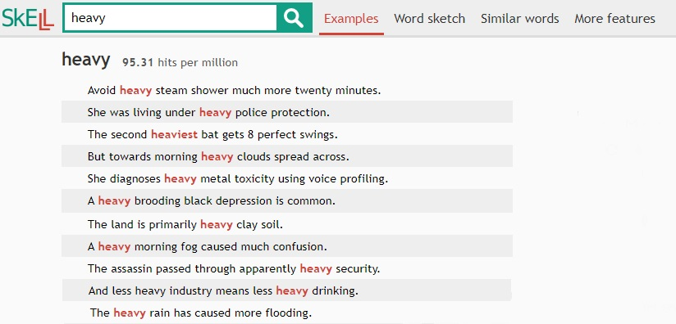
SkeLL: examples

Slide 23
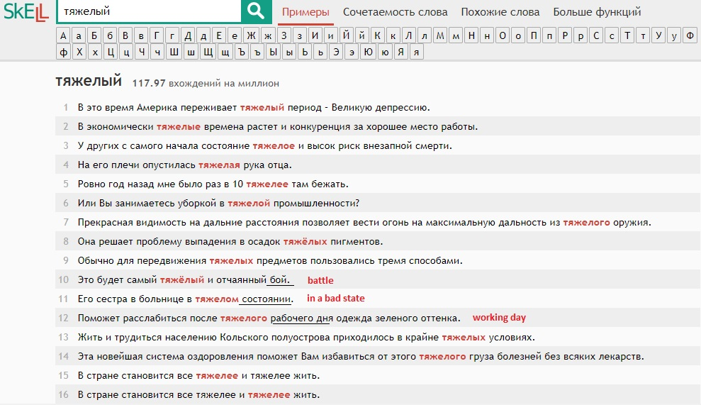
RuSkeLL: examples

Slide 24
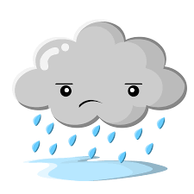
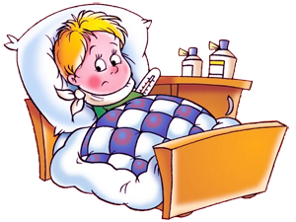
Differences that leap to the eye in sketches and examples:
Russian
(main metaphorical extentions):
‘difficult’:
tjazhelyj boj ‘uphill battle’,
tjazhelaja rabota ‘uphill task,
hardtask, drudgery’
‘physically bad’: tjazheloe sostojanie
‘critical condition, serious
condition’
English (main metaphorical extentions):
‘intense precipitation’:
heavy rain, heavy snow,
heavy fog
‘intense activity’:
heavy security
‘a lot’: His words were
heavy with sarcasm

Slide 25
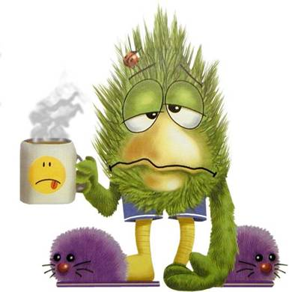
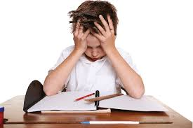
Even identical phrases get different interpretations
Тяжелое утро ‘hard, difficult to bear’
U menja bylo tjazheloe utro posle vcherashnego korporativa
‘I had a bad morning after
yesterday’s company party’
Cf. Blue Monday
Heavy morning ‘with a lot of activity’
I’ve got a heavy morning
tomorrow, I want to go to
sleep early

Slide 26
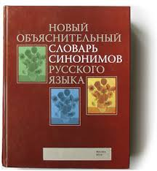
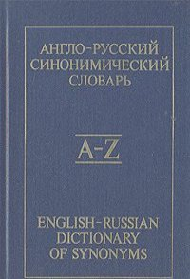
Today’s topic: conceptualization of distance
Objective: “to catch” differences in polysemy and subtle semantic distinctions within senses.
I will provide a sample – description of the English semantic field ‘far’
Sources:
Yury Apresyan’s “English-Russian dictionary of synonyms”
http://www.ruslang.ru/agens.php?id=text_noss2_title
the findings of multilingual synonyms group at HSE
(Masha Zarifyan, Nastya Melnik, Tanya Shalganova, Lyuba Polyanskaya,
Liza Kuzmenko, Kolya Mikulin (students), Tatyana Reznikova,
Anastasia Vyrenkova, Valentina Apresyan (PIs))
Special thanks to Masha Zarifyan for helping with the handout and
the presentation

Slide 27
List of words
far
distant
far-off
far-away
remote
First, I will consider polysemy
Second – certain differences within senses Third - idioms

Slide 28
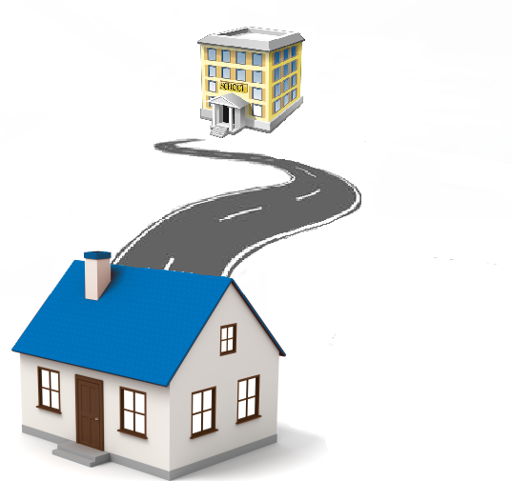
Space
1.1. Located at a distance from the speaker or reference point
He enjoyed travelling to distant <far-off> lands.
They went to exotic and faraway locations
The school is far from home Hubble space telescope tracked the most
remote galaxy ever observed

Slide 29
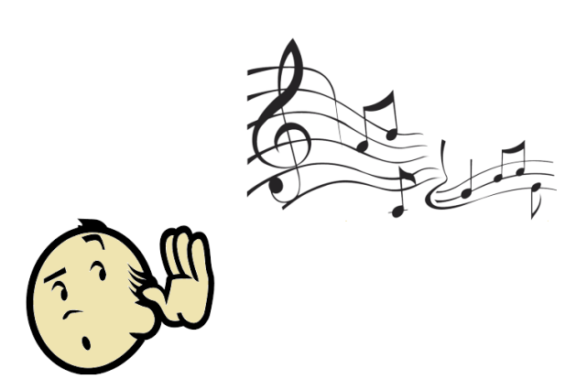
Space
1.2. Requiring to travel a long distance
It’s a far journey.
No one would do the far trip to Portugal just for skiing.
1.3. Perceived from a long distance
He heard a far voice calling.
The long lonely nights when all that can be seen are distant lights on the lake.
The distant sound of thunder.

Slide 30
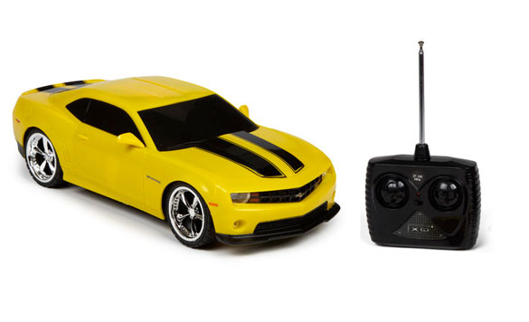
Space
1.4. Without actual contact.
I take care of my child, so I’m looking for a remote job.
Remote control <access, monitoring, host, server, PC, user>.

Slide 31
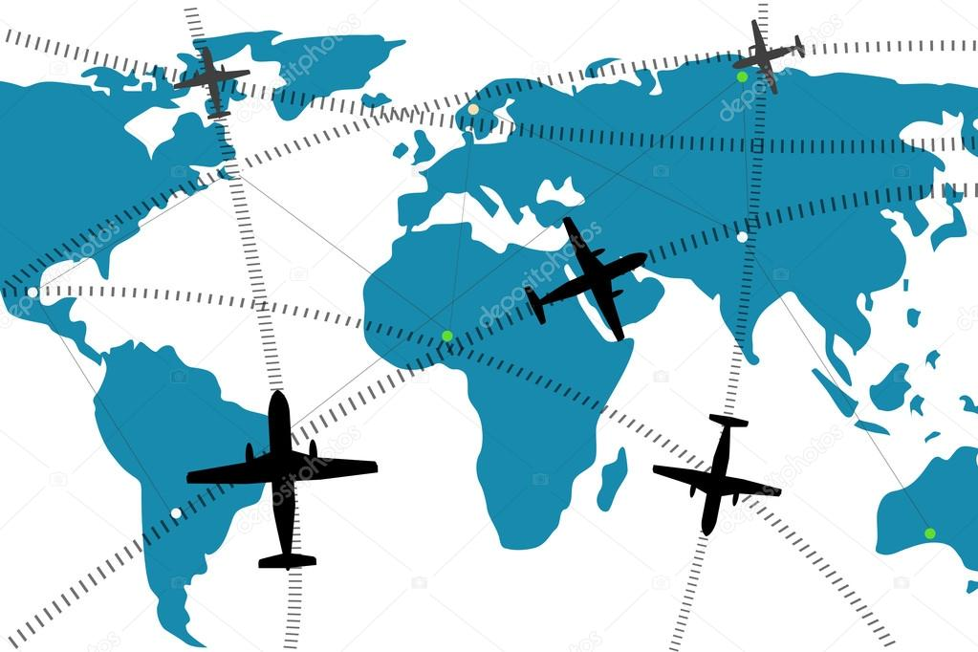
Space
1.5. Arriving from or going to a great distance:
I have here a distant letter from Japan.

Slide 32
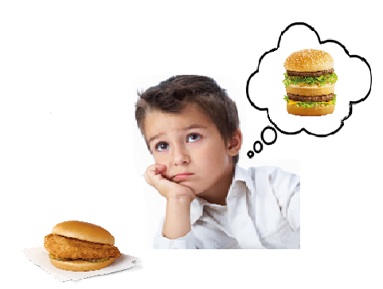
Virtual space
2.1. ‘Not conforming to the ideal, norm, goal, or expectations’ :
This hamburger is far from the ideal.
All these theories seem very remote from our everyday experience in the classroom. The challenges thus are far from being resolved . Far from normal <universal, complete>.
Her poise is as remote from his temper as it’s possible to be.
Remote from reality <standard, everyday experience>.
2.2. ‘Indirect, secondary’
The remote causes of the war

Slide 33
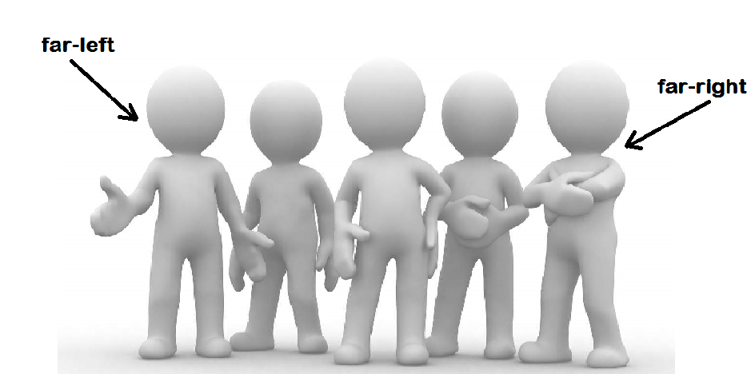
Degree + Space
3.1.‘Nearest one side or end of an object’
I’m the one on the far left <right>.

Slide 34
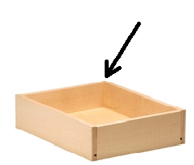
Degree + Space
3.2. ‘Located at the end or side of an object that is at a greater distance from the observer’
She moved to the far side of the bed to make room. Far side<corner, end, edge>.

Slide 35
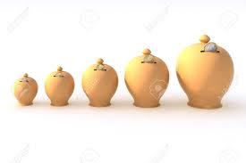
Pure degree
3.3. ‘The slightest’
She was not in a remotest way to blame.
You have only the remotest chance of winning the lottery.
Remotest possibility <idea, degree, chance>.

Slide 36
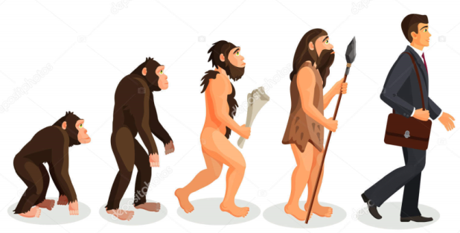
Time
4.1. ‘A long time ago/at a distant date in the future’
One day, in the distant future, I might go and live abroad. In the distant past there was no separation between man and animal.
Distant event <memory>.
4.2. ‘Of a person related to you who lived a long time ago/will live in the distant future’
Our remote <distant> ancestors lived in primordial oceans.
Odin is a remote <distant> descendant of Thor, removed by twelve generations.
Royal family membership may extend to distant descendants of a monarch. Cousin marriage is a marriage between people with a common grandparent or other more distant ancestor.

Slide 37
Kinship
‘Distantly related by blood or marriage’.
He was a distant cousin of Henry James.
Distant cousin <relative, aunt, uncle>.

Slide 38
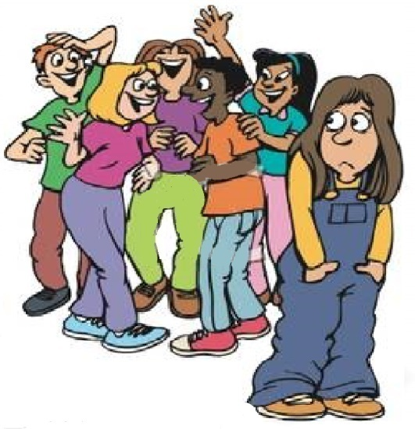
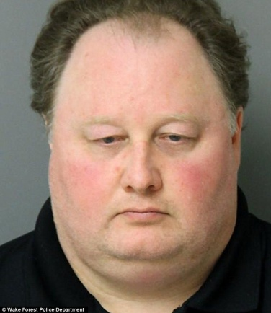
Mental / emotional
6.1. ‘Reserved in manner’:
She was polite but very remote when I met her.
In a cold and distant voice he told me to pack and leave.
6.2 ‘Not focused on the surroundings’.
He gave me a distant look and I wondered if he recognized me.
A woman with a far-away look in her eyes.

Slide 39
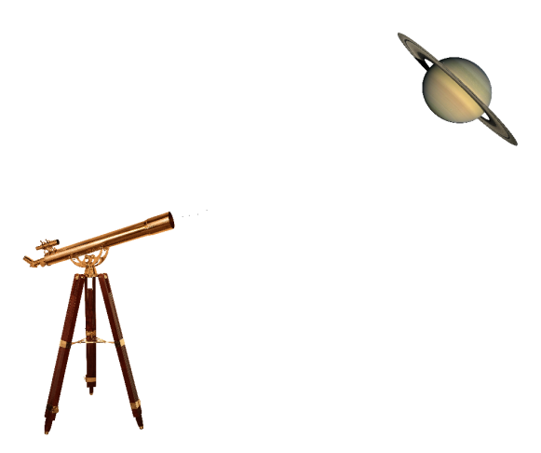
Semantic features (spatial meaning):
Distance
- Specific distance possible (special constructions):
How far is it from here?
The plants are six inches distant in the row.
- Very large distance:
far-off, far-away
impossible*a little far-off location,
?an extremely far-away country

Slide 40
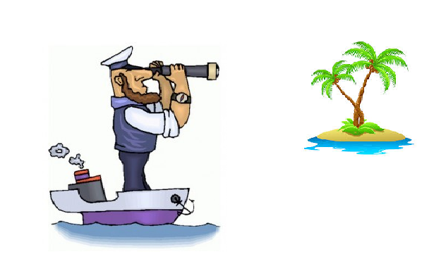
Semantic features (spatial meaning):
Reference point
Observer or another object:
The coast was far; He looked at the distant coast (observer);
The school is far from home; a distant galaxy (another object)
-Center, inhabited areas: remote country,
remote corners of the world, remote village

Slide 41
Semantic features (spatial meaning):
3. Temporary / permanent location
He is far from us; The houses already looked like distant specks on the horizon (temporary);
He lives in a remote village (permanent).
4. Accessibility
Remote is accessible with difficulty:
This remote village is so out of the way that mail comes only once a week.

Slide 42
Semantic features (temporal meaning):
Future/past reference.
Cf. distant past / distant future (equally possible), but remote past / ?remote future (future reference is rare)

Slide 43
Semantic features (mental meaning):
Reason for distancing
She was distant with us (≈ ‘cold’):may be intentional
Her far-away look: absorbed in other thoughts
She listened to him with a remote air: feeling alien to smb.or smth.

Slide 44
Idioms:
Metaphoric extension: ubiquitous, all-encompassing
far and wide - ‘everywhere’
We were looking far and wide for the lost diamond ring.
Metaphoric extension: high achievement
to go far – ‘to an advanced point or stage’
This brilliant student will go far.
Metaphoric extension: difference
far cry – ‘something that is very different from something else’:
This food is a far cry from what we got in the cafeteria.

Slide 45
Idioms:
Metaphoric extension: deviation from the norm
to go too far – ‘to behave in a way that is unreasonable’:
Threatening legal action is really going too far.
Metaphoric extension: movement
so far, so good – ‘used for saying that someone or something
has been successful up to this point’
So far, so good – 96 per cent of calls have been answered
within six seconds.
Metaphoric extension: yet unknown
dim and distant – ‘distant in the past or future’:
He retreats into memories from his dim and distant past.
It’s a dim and distant prospect.

Slide 46
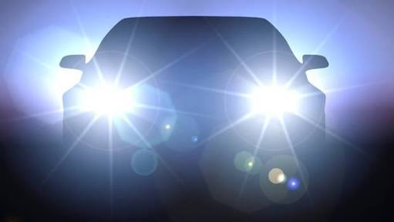
Points of digression among languages:
Differences within senses (of headlamps – light going at a great distance):
dal’nij svet – ‘far light’,
éclairage-route ‘lighting-road’,
Fernlicht ‘far light’,
abbagliante ‘blinding’
Differences in the polysemy:
far right but krajnij pravyj ‘side right’, d'extrême droite
She was distant with us – Ona byla xolodna s nami ‘She was cold with us’

Slide 47
Dalekij: mental and volitional meaning:
Dalekij ot zhizni ‘far from life’, airy-fairy
Dalekij ot real’nosti ‘far from reality’
divorced from reality, not in touch with reality

Slide 48
Master class:
1. Collect the list of synonyms in your languages. Use Word Reference, Multitran.
2. Fill out the list of senses with the synonyms in your language. Identify discrepancies. Use introspection. Use Sketch Engine and Skell. Use other corpora.
3. Add new senses to the list of senses (if any).
4. Fill out (if applicable) the contrastive examples in the list of semantic features. Does your language have the same contrasts among synonyms within senses?
5. Add to the list of semantic features if you find other contrasts.
6. Create a list of idioms based on the suggested English list and
Corpora (look both at adjectives and adverbs).
7. Report on your findings.

