Slide 1
Typology of dimensions
Alexey Kozlov TyLex

Slide 2
Recapitulation
Dimensional terms describe physical objects in one of those dimensions
tall, long, thick, thin, but not big or small
Topological classes are several prototypical shapes, around which the object which can be described by the DTs tend to agglomerate
Atomic functions on our semantic map (= frames): dimensions of certain topological classes
thin pivots, thin layers, wide stripes, wide roads, etc.
altus vs. latus
“large size” vs. “small size”

Slide 3
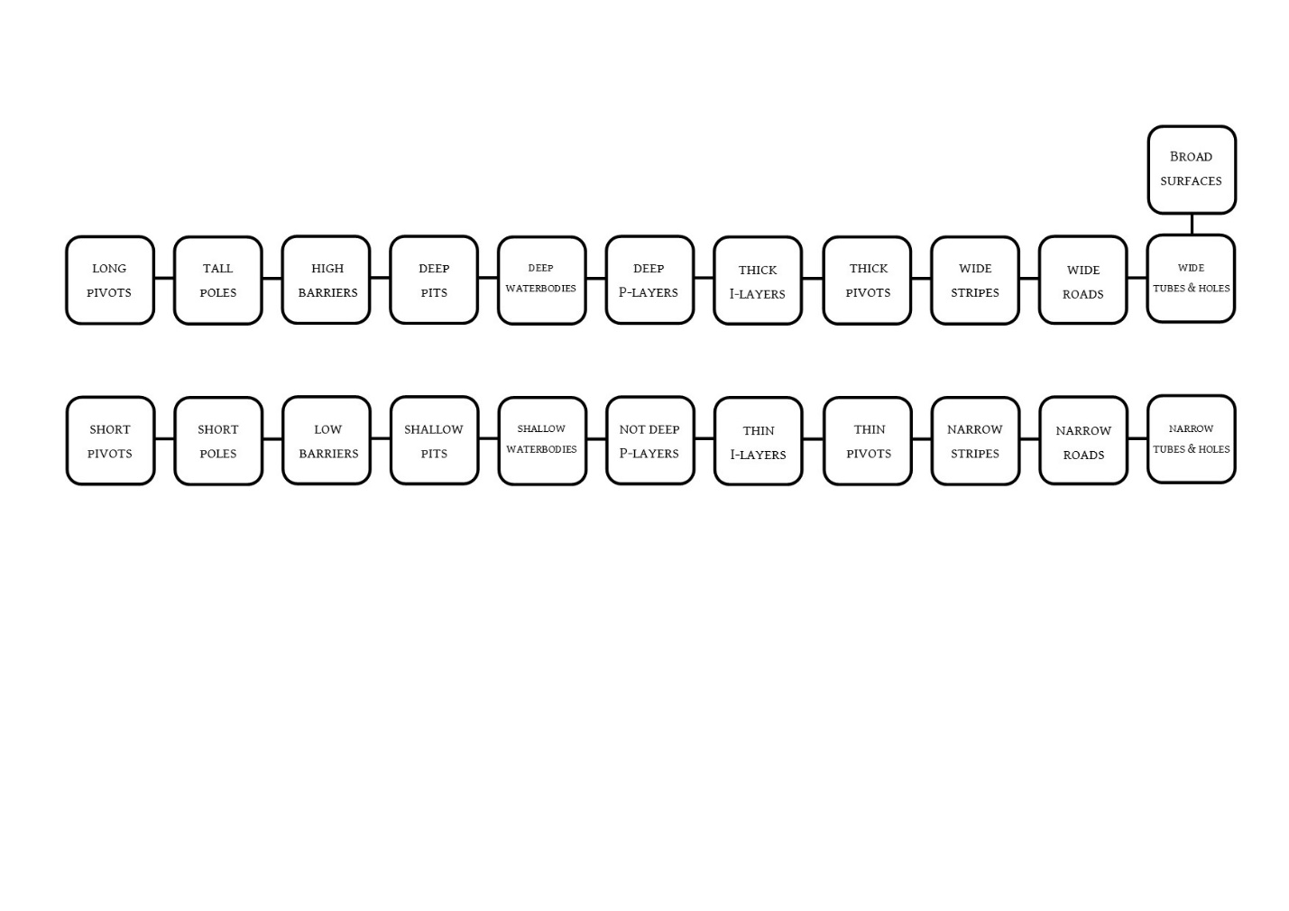
Recapitulation
The semantic map of dimensions is long (and thin)
altus
latus

Slide 4
SAE systems
“Canonical” in the Corbettian sense: long vs. high vs. deep
 |  | depth | height | length
Kabardian | + | kʷwə | λaγe | č̣’əh
 | — | č’enǯ’ | λaχč’e | č̣’agʷe
Russian | + | глубокий | высокий | длинный
 | -- | мелкий | низкий | короткий

Slide 5
SAE systems
“Canonical” in the Corbettian sense: long vs. high vs. deep
 |  | depth | height | length
Kabardian | + | kʷwə | λaγe | č̣’əh
 | — | č’enǯ’ | λaχč’e | č̣’agʷe
Russian | + | глубокий | высокий | длинный
 | — | мелкий | низкий | короткий

Slide 6
Questions
What more subtle distinctions within altus can be provided?
How the boundaries can be conflated?

Slide 7
High vs. tall
tall poles vs. high barriers
English:
highest relative frequency of collocation with tall: chimney and mast.
immediately followed by stool, grass, tower, building and tree
nouns denoting humans come only afterwards
 | poles | barriers
+ | tall | high
—

Slide 8
High vs. tall
tall poles vs. high barriers
English:
highest relative frequency of collocation with tall: chimney and mast.
immediately followed by stool, grass, tower, building and tree
nouns denoting humans come only afterwards
 | poles | barriers
+ | tall | high
— | short | low

Slide 9
High vs. tall
tall poles vs. high barriers
English:
highest relative frequency of collocation with tall: chimney and mast.
immediately followed by stool, grass, tower, building and tree
nouns denoting humans come only afterwards
 | pivots | poles | barriers
+ | long | tall | high
— | short |  | low

Slide 10
High vs. tall
 |  | ‘high/tall’ – ‘low’
 |  | Barriers | Poles
Aghul | + | hava
 | - | x̜eba | džiqqe
Itsari Dargwa | + | caӿ
 | - | ƣuk | qant̨
Avar | + | borxatab
 | - | t’uᵴab | t’uᵴab

Slide 11
Deep and shallow: further distinctions
russian
a. ne-glubokaja reka melkaja reka
‘shallow river’ ‘shallow river’
b. ne-glubokij ovrag melkij ovrag
‘shallow ravine’ ‘small ravine’

Slide 12
Deep and shallow: further distinctions
Why melkij has such narrow combinability?
 | pits | waterbodies | P-layers
+ | glubokij
— | neglubokij
 |  | melkij

Slide 13
Mergers
 |  | depth | height | length
Kabardian | + | kʷwə | λaγe | č̣’əh
 | — | č’enǯ’ | λaχč’e | č̣’agʷe

Slide 14
DH-Merger
 |  | depth | height | length
Anti-Kabardian-1 | +
 | —

Slide 15
HL-Merger
 |  | depth | height | length
Anti-Kabardian-2 | +
 | —

Slide 16
DH-merger
Latin altus ‘high, deep’
Swahili, Tzotzil (according to http://clics.lingpy.org)
Our sample: 5 Finno-Ugric languages
Izhma Komi
Udmurt
Moksha
Finnish
Western Khanty

Slide 17
DH-merger
western khanty
a. măł / łeł as
deep low river
b. kărsʼ / łeł juχ
high low tree
c. mał / *łeł / aj łɔnʼsʼ
deep shallow small snow

Slide 18
DH-merger
(13) finnish
a. syvä / matala kuoppa
deep shallow pit
b. korkea / matala muuri
high low wall
c. ??syvä / ??matala lumi
deep shallow snow

Slide 19
DH-merger
 |  | P-Layers | Water Bodies | Pits | Barriers | Poles | Pivots
Western Khanty | + | mał |  |  | kărsʼ |  | χuv
 | - | aj ‘small’ | łeł |  |  |  | wan
Finnish | + | ??syvä | syvä |  | korkea |  | pitkä
 | - | ??matala | matala |  |  |  | lyhyt

Slide 20
DH-merger
beserman udmurt
a. ǯʼužət / mur / lapeg gu
deep deep shallow pit
b. *ǯʼužət /mur / lapeg reka
deep deep shallow river
c. ǯʼužət / lapeg ken’er
high low fence
d. mur /??lapeg / piči lə̑mə̑
deep shallow small snow

Slide 21
DH-merger
 |  | ‘deep’ – ‘shallow’ |  |  | ‘high/tall’ – ‘low’ | ‘high/tall’ – ‘low’ |  | ‘long’ – ‘short’
 |  | Layers | Water Bodies | Pits | Barriers | Barriers | Poles | Pivots
Beserman Udmurt | + | mur |  |  |  |  |  | kuž'
 |  |  |  | ǯʼužət
 | - | (small) | lapeg |  |  |  |  | vakčʼi
Moksha Mordvin | + | kər̥ka |  |  |  |  |  | kuvaka
 |  |  |  | ser’i
 | - | (small) | mac’ɛ | aln’ɛ |  |  |  | n’ur̥kɛn’ɛ

Slide 22
HL-merger
Kazakh
 | ‘high/tall’ – ‘low’ |  | ‘long’ – ‘short’
 | Barriers | Poles | Pivots
+ | bïik
 |  | üzın
- | alasa
 |  | qısqa

Slide 23
HL-merger
 |  | ‘high/tall’ – ‘low’ |  | ‘long’ – ‘short’
 |  | Barriers | Poles | Pivots
Aghul | + | hava |  | irhe
 | - | x̜eba | džiqqe
Itsari Dargwa | + | caӿ |  | buӿen
 | - | quk | qant̨

Slide 24
Izhma Komi: both DH & HL mergers
 | ‘deep’ – ‘shallow’ |  |  | ‘high/tall’ – ‘low’ |  | ‘long’ – ‘short’
 | Layers | Water Bodies | Pits | Barriers | Poles | Pivots
+ | džudžɨd |  |  |  | kuz’
- | l’apkɨd |  |  |  |  | džen’ɨd

Slide 25
Altus semantic map

Slide 26
Merger constraint
Yesterday: If the boundary between thick pivots and narrow stripes is violated in large sizes, it should be violated in small sizes
Something like this goes on in altus as well:
Boundaries between long pivots vs. tall poles, high barriers vs. deep pits cannot be violated in large sizes without a “harmonic violation” in small sizes

Slide 27
Merger constraint
Canonical boundaries: used by the SAE-systems
long pivots vs. tall poles
high barriers vs. deep pits
thick pivots vs. wide stripes
depth | height | length
thickness | width

Slide 28
Canonical boundaries

Slide 29
Canonical boundaries

Slide 30
altus meets latus
Impenetrable and Penetrable Layers sometimes get colexified
Penetrable Layers also get colexified with waterbodies
Kazakh
 | Water bodies | Penetrable Layers | Layers
+ | tereŋ | qalin
- |  | žyka

