Slide 1
Typology of dimensions
Alexey Kozlov
TyLex

Slide 2
Arma virumque cano, Troiae qui primus ab oris
Italiam, fato profugus, Laviniaque venit
litora, multum ille et terris iactatus et alto
vi superum saevae memorem Iunonis ob iram;
multa quoque et bello passus, dum conderet urbem,
inferretque deos Latio, genus unde Latinum,
Albanique patres, atque altae moenia Romae.

Slide 3
Vergil’s Aeneid
Arma virumque cano, Troiae qui primus ab oris
Italiam, fato profugus, Laviniaque venit
litora, multum ille et terris iactatus et alto
vi superum saevae memorem Iunonis ob iram;
multa quoque et bello passus, dum conderet urbem,
inferretque deos Latio, genus unde Latinum,
Albanique patres, atque altae moenia Romae.

Slide 4
Latin altus
altum mare ‘deep see’
altissima flumina ‘deep river’
altus puteus ‘deep well’
altae moenia Romae ‘high walls of Rome’
altus acervus ‘high pile’
alta turris ‘high tower’

Slide 5
Latin altus
Polyfunctionality
high + deep?
…or rather tall + deep?
…or rather high + tall + deep?
…
Komi džudžɨd: exactly the same pattern
džudžɨd lɨm / ju / jama / zabor / pu
deep_high snow river pit fence tree

Slide 6
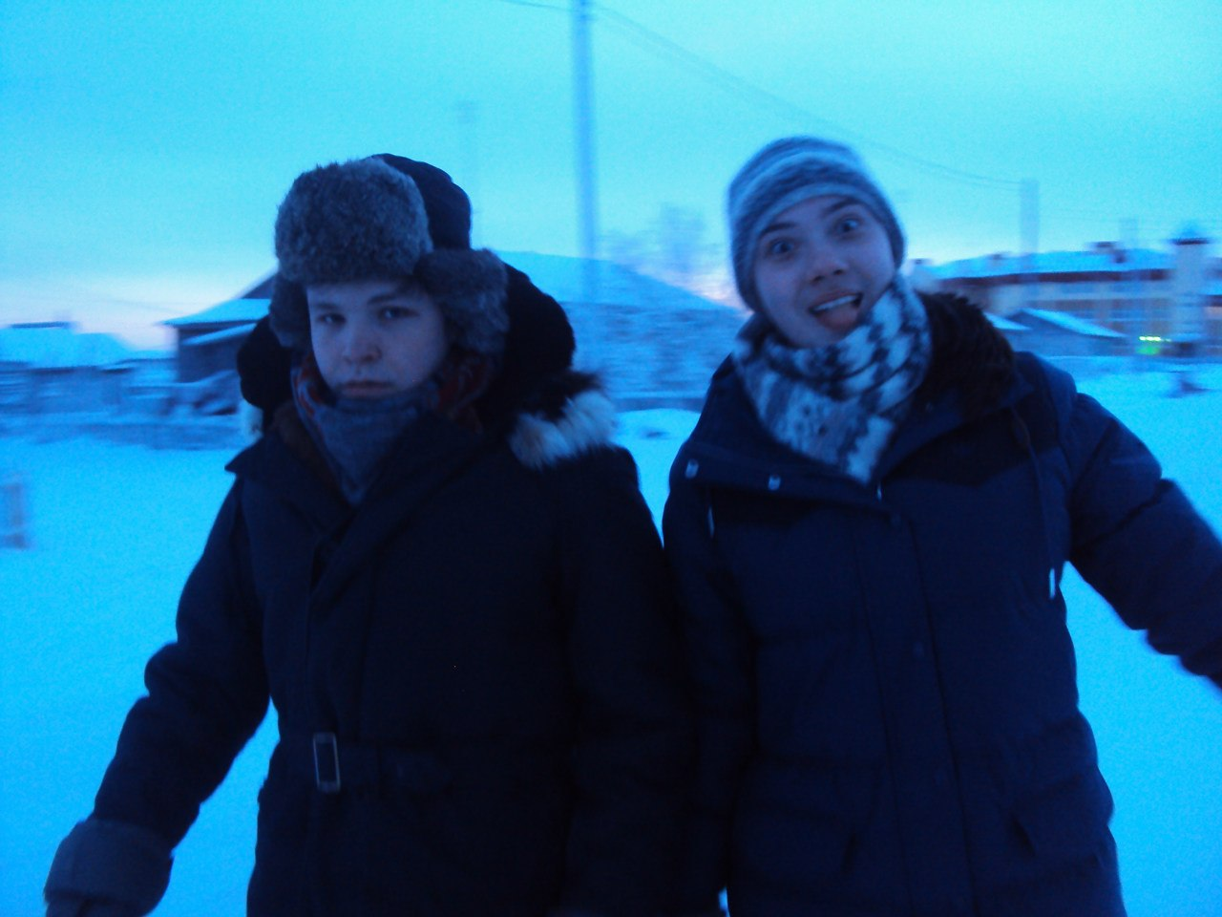
Typology of dimensions
Maria Privizentseva (Lomonosov MSU) and Alexey Kozlov
Cross-linguistic variation of dimensional terms
  high, tall, deep, etc.
DA: adjectives that describe one of the dimensions of a certain physical objects
  not big or small

Slide 7
Some history: Bierwisch & Lang
Bierwisch, Manfred, and Ewald Lang (1989). Dimensional adjectives: grammatical structure and conceptual interpretation. Berlin; Heidelberg: Springer-Verlag
Ways of dimensions’ conceptualization are language-specific

Slide 8
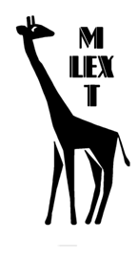
Our project
Part of the MLexT enterprise
Focuses rather on the colexification patterns of dimensional languages (cf. Latin altus)
Glosses over the subtle differences like culture-specific patterns of conceptualization
Usual MLexT methodology: questionnaries (and corpora)

Slide 9
Sample
40 languages
  convenience sample
  too far a convenience sample…
  mostly Northern Eurasia
Uralic languages: nearly all genera
  Finnish, Moksha, Hill Mari, Meadow Mari, Udmurt, Komi-Zyrian, Western Khanty
  Tundra Nenets, Nganasan

Slide 10
Dimensions
Assume you want to describe one of dimensions of a certain physical object
How are you going to indicate what dimension you are describing?
*a tall ball *a high goose
The dimension to describe should be salient
  either on the basis of its inherent spatial properties (shape in size)
  or on the basis of the ways humans interact with such objects

Slide 11
Dimensions
When you assert that the object is thick, you assume it has a dimension it can be thick in
Dimensional terms apply but to several classes of nouns which denote objects with salient dimensions
  not balls or geese or headphones;
(or they can coerce a noun into such class:
long lake ‘the lake has elongated shape’)

Slide 12
Topological classes
For all languages of our sample, all objects which can be described with dimensional adjectives agglomerate around a small number of prototypical shapes
Of course, if we zoom in, more and more subtle semantic oppositions can always be provided
However, some distinctions prove to be typologically relevant, and some are not

Slide 13
Topological classes
kazakh
(2) a. ensiz (*tar) taqta
narrow board
b. tar (*ensiz) žol
narrow road
c. tar (*ensiz) tesik
narrow hole
tar: narrow spaces:
  passages,
  tubes,
  doors,
  roads.
ensiz: flat and long artifacts:
  ribbons
  stripes on a dress
  wooden boards

Slide 14
Topological classes
The distinction between stripe-shaped artifacts and elongated spaces has turned out to be relevant
Some others are not:
E. g. the way the length or thickness of elongated objects is lexicalized does not depend on whether they are flexible or rigid (ropes vs. sticks)

Slide 15
Topological classes
Classes that turned out to be typologically relevant (so far):
pivots: ropes, threads, sticks, fingers
poles: trees, guide-posts, columns, humans
barriers: walls, fences, ramparts
impenetrable layers: books, blankets, boards, ice, cloth
penetrable layers: snow, mud, sand

Slide 16
Topological classes
Stripes: ribbons, wooden boards, stripes on a dress
Roads: streets, rivers, paths, bridges
Surfaces: fields, glades, yards
Holes: doors, windows, holes in a wall
Tubes: chimneys, pipes, corridors, burrows
Pits: ditches, trenches, coal mines
Waterbodies: rivers, lakes, pounds

Slide 17
Frames
Dimensions of a particular topological class
Long pivots vs. thick pivots
“Small sizes” vs. “large sizes” subdomains (labels + & - )
narrow stripes vs. narrow roads (⇐ Kazakh)
⇓⇓⇓
wide stripes vs. wide roads
We project automatically each distinction attested for the small sizes subdomain to the large sizes and vice versa
  that is because we hope to capture assymetries at the later stages

Slide 18
Semantic map
Kazakh: narrow stripes vs. narrow roads & narrow holes
Tundra Nenets: narrow stripes & narrow roads vs narrow holes
(So far) not occurred: narrow stripes & narrow holes vs narrow roads
narrow
stripes
narrow
roads
narrow
holes
wide
stripes
wide
roads
wide
holes

Slide 19
Semantic map
Our semantic map itself turned out to be a pivot
  just a chain of frames
  it’s long and thin
  and does not even fit in this slide!
So we divided our domain into two parts:
  altus terms = long, tall, high, deep etc.
  latus terms = thick, wide, broad etc.
FRAME
FRAME
FRAME
FRAME
FRAME

Slide 20
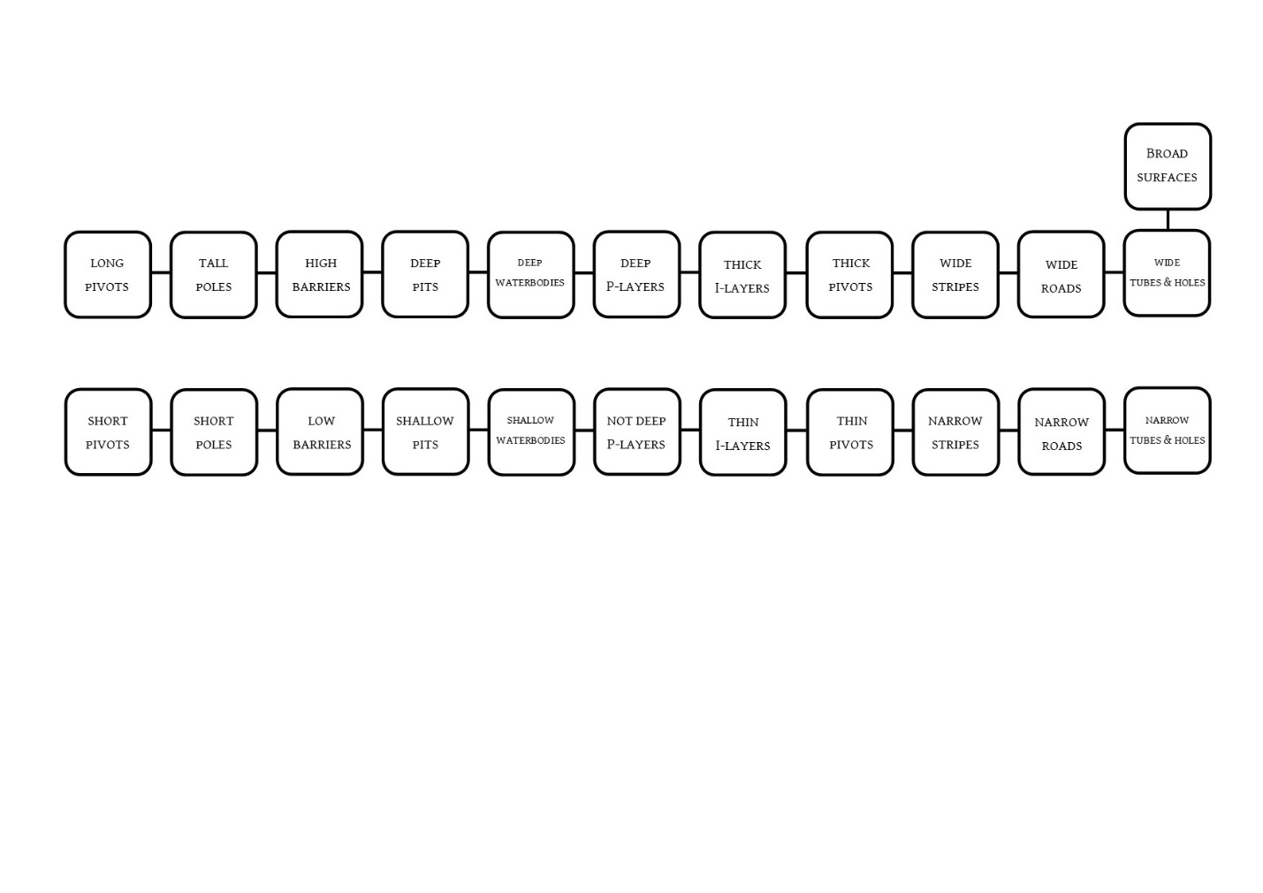
altus
latus

Slide 21
Symmetry
Asymmetries are typical of colexification patterns in many semantic domains: antonymical frames are construed and colexified differently
  cf. temperature (Maria Koptjevkaja-Tamm (ed.) 2015)
In this context, the semantic map of dimensions looks strikingly symmetrical
There are cases of assymetrical colexification, but they are not that abundant (in comparison with other domains)

Slide 22
“Paradigm levelling” in Old East Slavic
Zaliznyak 1985:
In Common Slavic, there was free variation in what suffixes dimensional adjectives attach: -ok- or –ъk-
glub-ok-ъ ~ glub-ъk-ъ ‘deep’ měl-ok-ъ ~ měl-ъk-ъ ‘shallow’
vys-ok-ъ ~ vys-ъk-ъ ‘high’ niz-ok-ъ ~ niz-ъk-ъ ‘low’
šir-ok-ъ ~ šir-ъk-ъ ‘wide’ uz-ok-ъ ~ uz-ъk-ъ ‘narrow’
(dlin-ьn-ъ ‘long’) korot-ok-ъ ~ korot-ъk-ъ ‘short’
In XII—XIII centuries, the variation disappeared
Each adjective got a fixed stem

Slide 23
“Paradigm levelling” in Old East Slavic
Zaliznyak 1985:
In Common Slavic, there was free variation in what suffixes dimensional adjectives attach: -ok- or –ъk-
glub-ok-ъ ~ glub-ъk-ъ ‘deep’ měl-ok-ъ ~ měl-ъk-ъ ‘shallow’
vys-ok-ъ ~ vys-ъk-ъ ‘high’ niz-ok-ъ ~ niz-ъk-ъ ‘low’
šir-ok-ъ ~ šir-ъk-ъ ‘wide’ uz-ok-ъ ~ uz-ъk-ъ ‘narrow’
(dlin-ьn-ъ ‘long’) korot-ok-ъ ~ korot-ъk-ъ ‘short’
In XII—XIII centuries, the variation disappeared
Each adjective lexicalized its own suffix

Slide 24
Latus

Slide 25
thick layers vs. thick pivots
 | Kabardian
 | Layers | Pivots
+ | ʔ^{w}əv | ʁʷəm
- | pače | psəʁ^{w}e
 | Kazakh
 | Layers | Pivots
+ | qalıŋ | žuan
- | žıka | žiŋiške

Slide 26
thick layers vs. thick pivots
Abaev 1933, Chirikba 2008: layers vs. pivots distinction in the zone of thick is a particular trait of “Caucasian Sprachbund”. This pattern of colexification is attested in:
  Kartvelian (Georgian and Svan)
  North-West Caucasian (Adyghe, Abkhaz and Kabardian)
  North-East Caucasian (Dargwa, Tsakhur)
  Ossetic
Our sample: Mandarin Chinese, Tatar, Kazakh, Akebu (<Kwa), Western Khanty, Tundra Nenets, Chukchee
Until proved the opposite, there is no point in seeing this pattern as characteristic of the Caucasian languages
It is very likely that these are the SAE languages which have a bias against it

Slide 27
thick layers & thick pivots
 |  | Layers | Pivots
Moksha | + | ɛčkə
 | — | t’ejn’ə
English | + | thick
 | — | thin
Russian | + | толстый
 | — | тонкий

Slide 28
thick layers & thick pivots
However, colexification of these two frames seems to be rather recurrent tendency even outside Europe
  Udi (<North-East Caucasian)
  Hebrew
  East Armenian
  Turkic
This tendency deserves an explanation
From the pure geometrical point of view, Pivots and Layers are not similar at all
  3D object vs. 1D object
Why colexify?

Slide 29
thick layers & thick pivots
In such languages, besides dominant thick there is often also dominant wide term
  wide stripes & wide roads & wide holes
So in fact thick is opposed to wide
The explanation seems to lie in the ways the human which observes or uses the object interacts with it
The thickness of pivots (sticks, ropes etc.) and layers (paper, cloth etc.) is prototypically estimated with hand
Wide objects are prototypically perceived from inside:
  we go along the road,
  get into the hole
  look into the tube,
  etc.

Slide 30
Dominant Wide vs. dominant Thick
The concept conveyed by thick-like terms is based on a particular sensorimotor feeling
That conveyed by wide-like terms width has to deal with our body schema
Sensory basis of colexification?
If so, in the colexifying languages both frames are “covered” with a word which from the emic point of view has a single meaning
(even though it still corresponds to two distinct comparative concepts)
…representational explanation?..

Slide 31
Different wide’s
stripes vs. roads vs. tubes & holes
In our sample, Roads are colexified with either stripes or tubes (or both)
 |  | Stripes | Roads | Tubes & Holes
Kazakh | + | qen
 | — | ensiz | tar
Tundra Nenets | + | latə
 | -- | tiya |  |  | pík

Slide 32
wide surfaces
Izhma Komi: a dedicated term for wide surfaces
Avar: one wide term can combine with surfaces, and the other cannot
No “small” size equivalent
 |  | Stripes | Roads | Tubes & Holes | Surfaces
Ɨzhma Komi | + | ota |  |  | paš’kɨd
Avar | + | ʢebab
 |  |  | ʢat’idab

Slide 33
Asymmetries within latus
The boundary between pivots & stripes (thick terms and wide terms) cannot be violated in “large sizes” and retained in “small sizes”
  Western Khanty
  Kabardian
  Buryat
  Udi
  Chukchi
If it is violated in “large sizes”, it should be violated in “small sizes”

Slide 34
Assymetries within latus
The boundary between pivots & stripes (thick terms and wide terms) can only be violated in small sizes
Western Khanty
 | Layers | Pivots | Stripes | Roads | Tubes & Holes
+ | kuł |  | vutəŋ
— | uoχəł | vaś

Slide 35
Asymmetries within latus
 | Besleney Kabardian
 | Layers | Pivots | Stripes | Roads | Tubes & Holes
+ | ʔ^{w}əv | ʁʷəm | fambʁʷe
__ | ṗač̣’e | psəʁ^{w}e
 |  |  | bʁʷəze

Slide 36
Asymmetries within latus
Chukchi
 | Layers | Pivots | Stripes | Roads | Tubes & Holes
+ | -qi- | -ʔum-
 |  |  | -aɬam-
— | -wəɬɣə- | -ɣət-
 |  |  | -er-
 |  |  |  | -sʔuw-

Slide 37
Assymetries within latus
Udi
 | Layers | Pivots | Stripes | Roads | Tubes & Holes
+ | bočʔu |  | geng
— | næzik

Slide 38
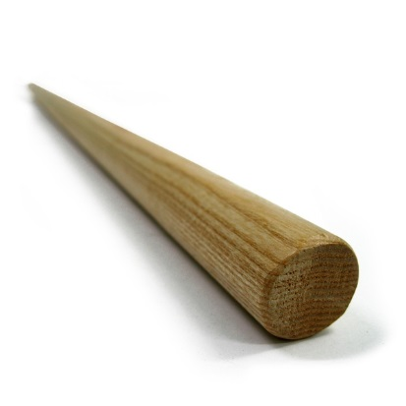
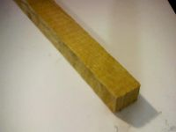
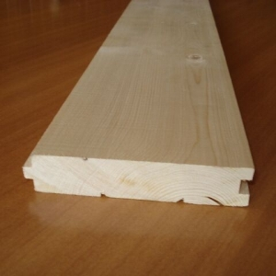

Assymetries within latus: how come?
An explanation (if we need one so far)
Small size smoothes out topological differencies
A narrow board (a lath, a strip of wood) resembles a thin stick much more than a wide board resembles a thick tree

Slide 39
latus and altus: a boundary
What is the connection between latus (wide-thick) and altus (high-deep-long-tall)?
…
FRENCH
J’ai tombé dans la neige épaisse
‘I fell into deep snow’
Impenetrable and Penetrable Layers sometimes get colexified
Penetrable Layers also get colexified with waterbodies

Slide 40
Next class (7.09)
Altus: high & deep, long & high mergers
Latus-Altus boundary
Diachrony of dimensional terms
No DT at all?

